Slide 1
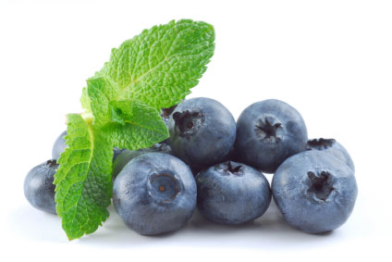
NBME 15 BLOCK 1
Skip to:
Block 1
Block 2
Block 3
Block 4

Slide 2
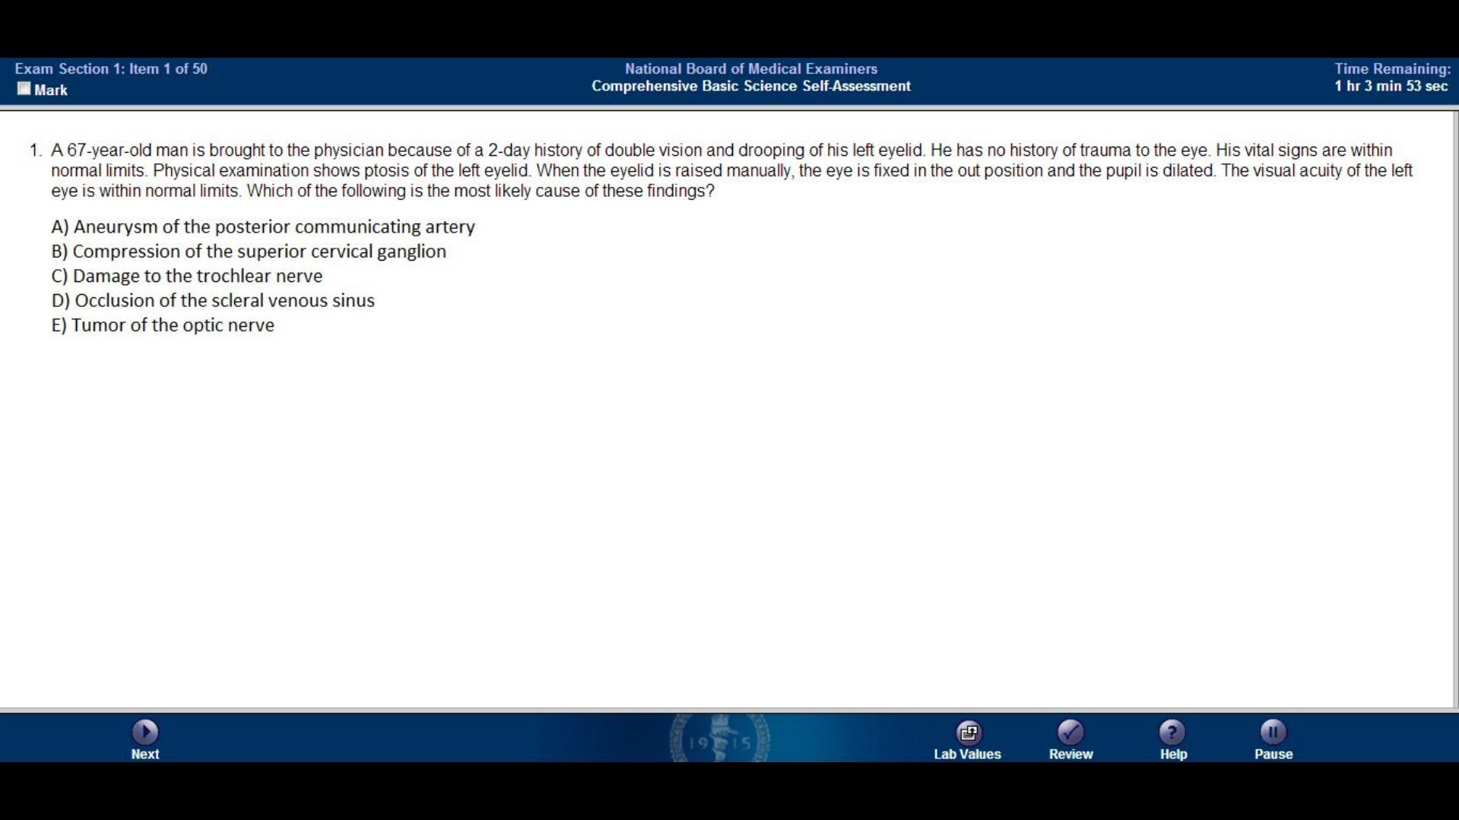

Slide 3
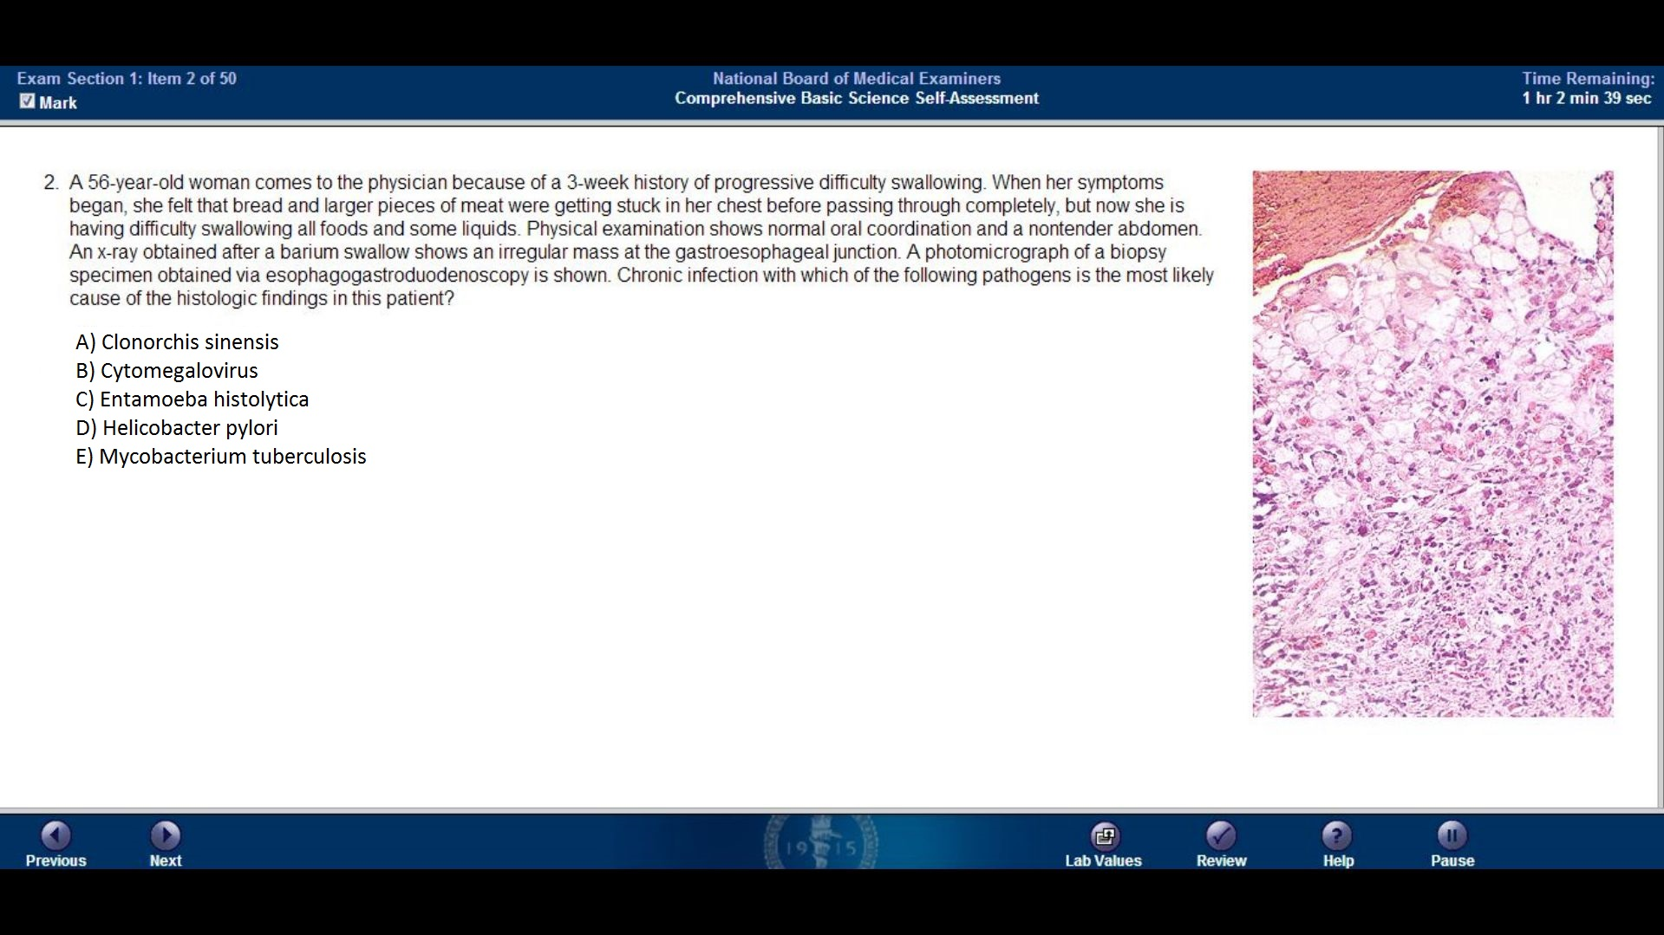

Slide 4
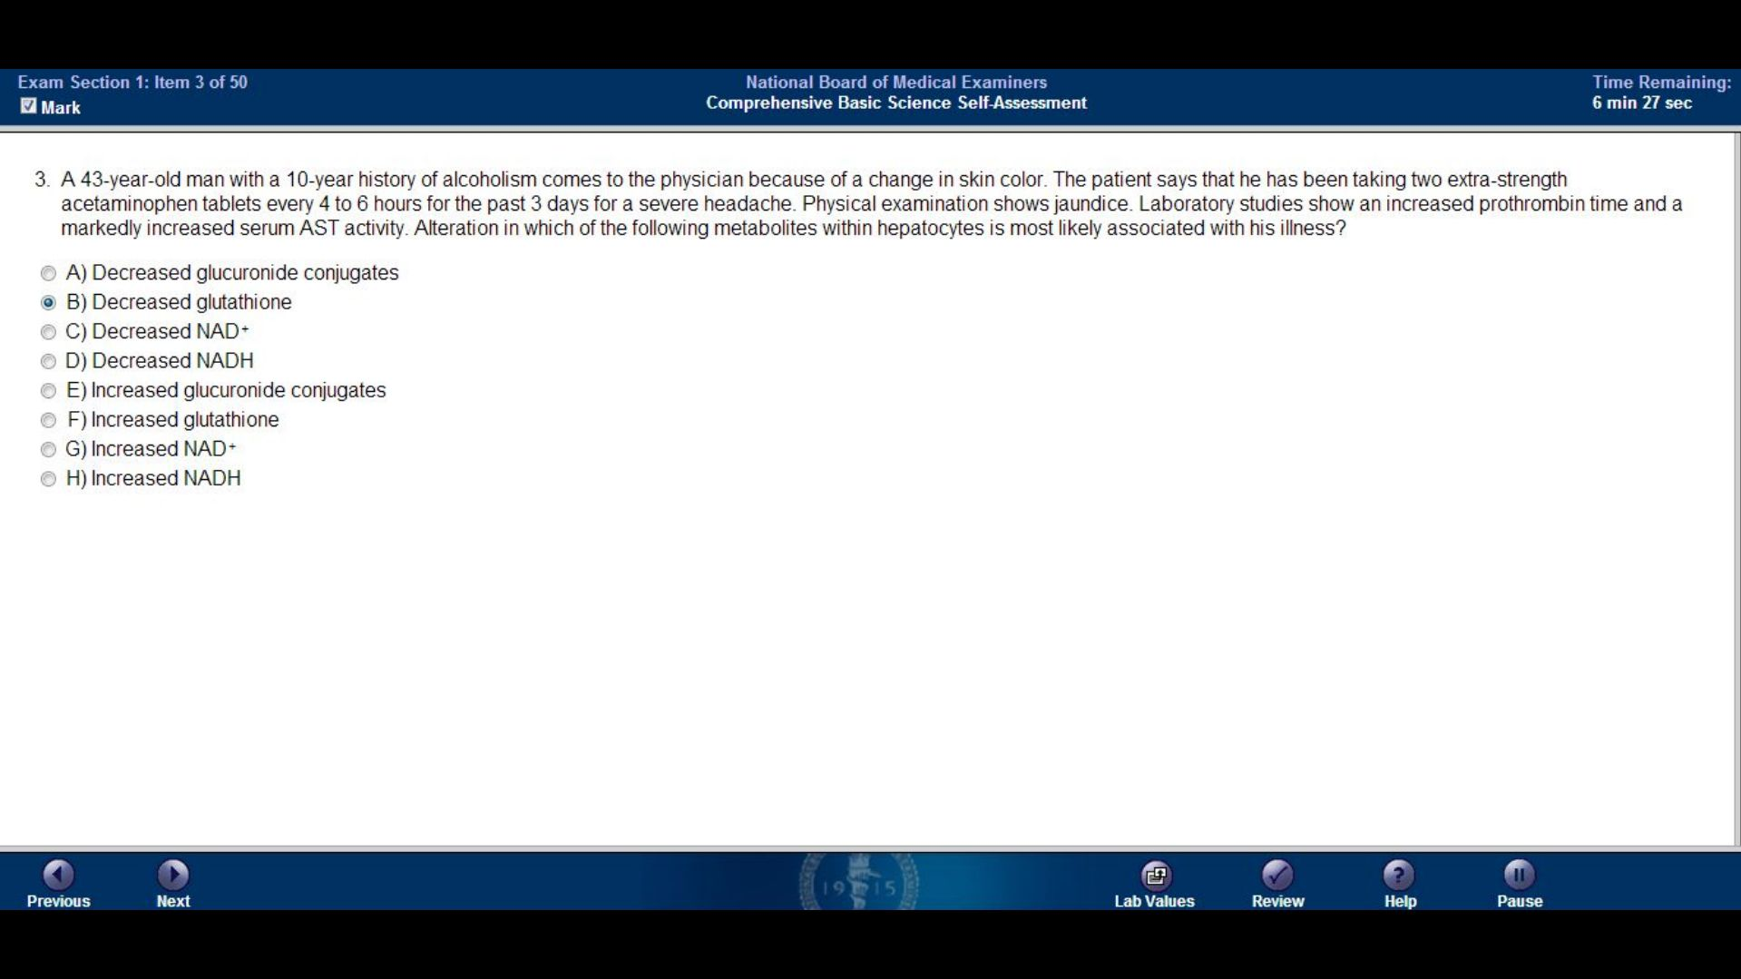

Slide 5
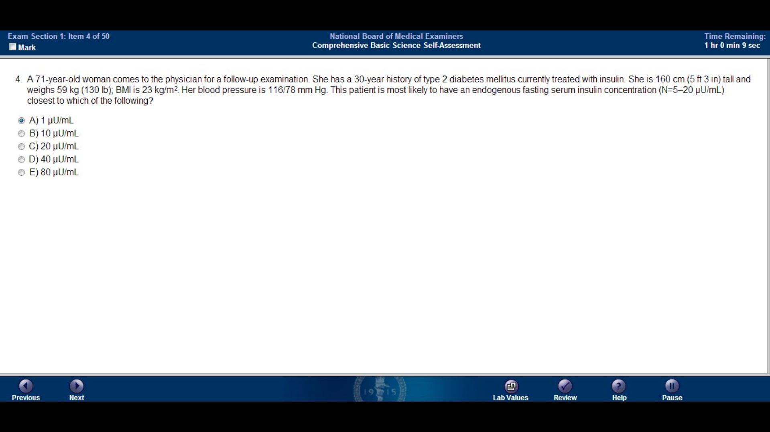

Slide 6
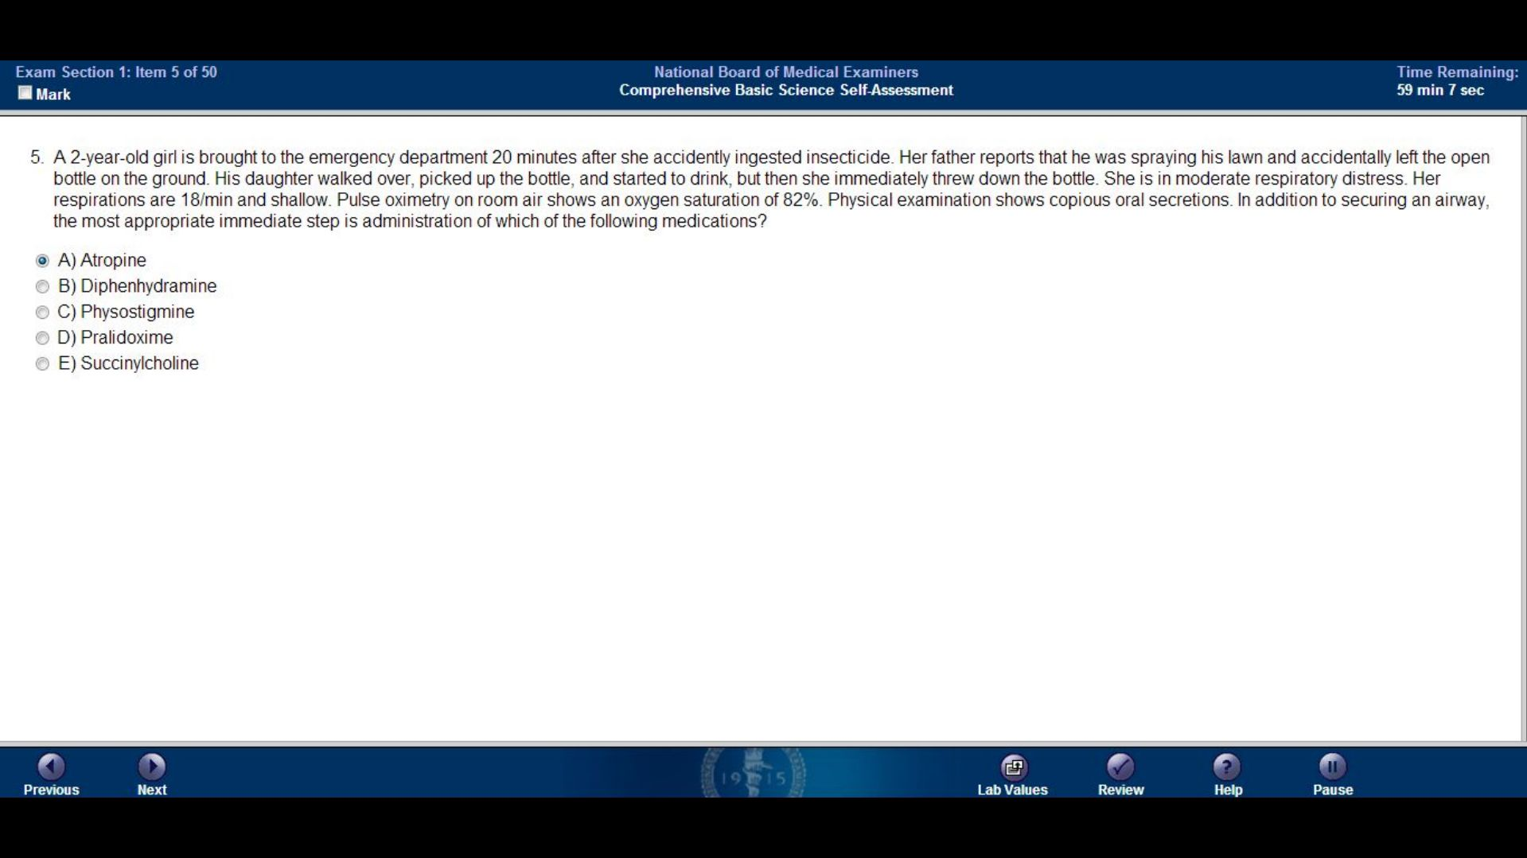

Slide 7
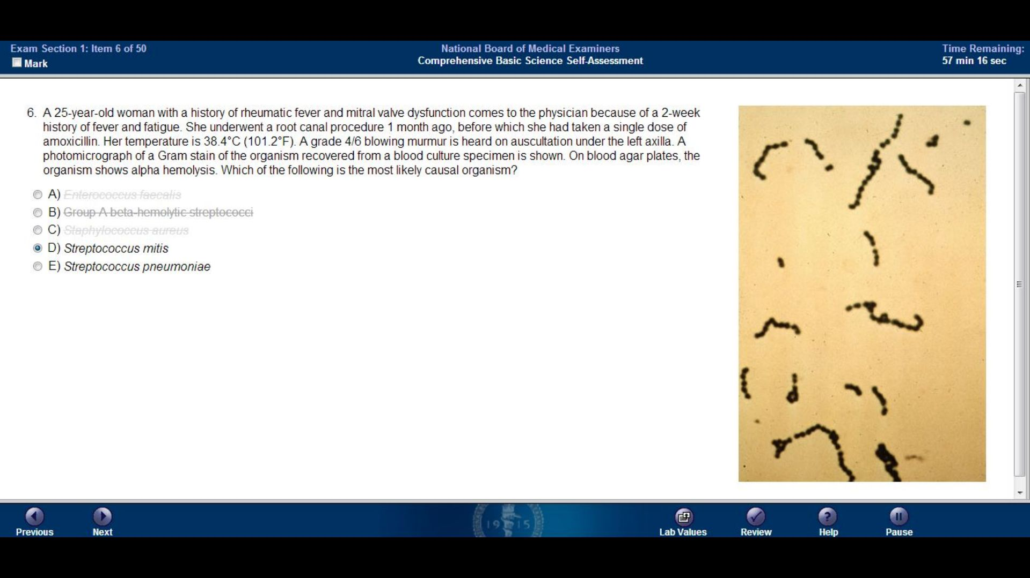
Enterococcus faecalis
Group A beta hemolytic streptococci
Staphylococcus aureus
Streptococcus mitis
Streptococcus pneumoniae

Slide 8
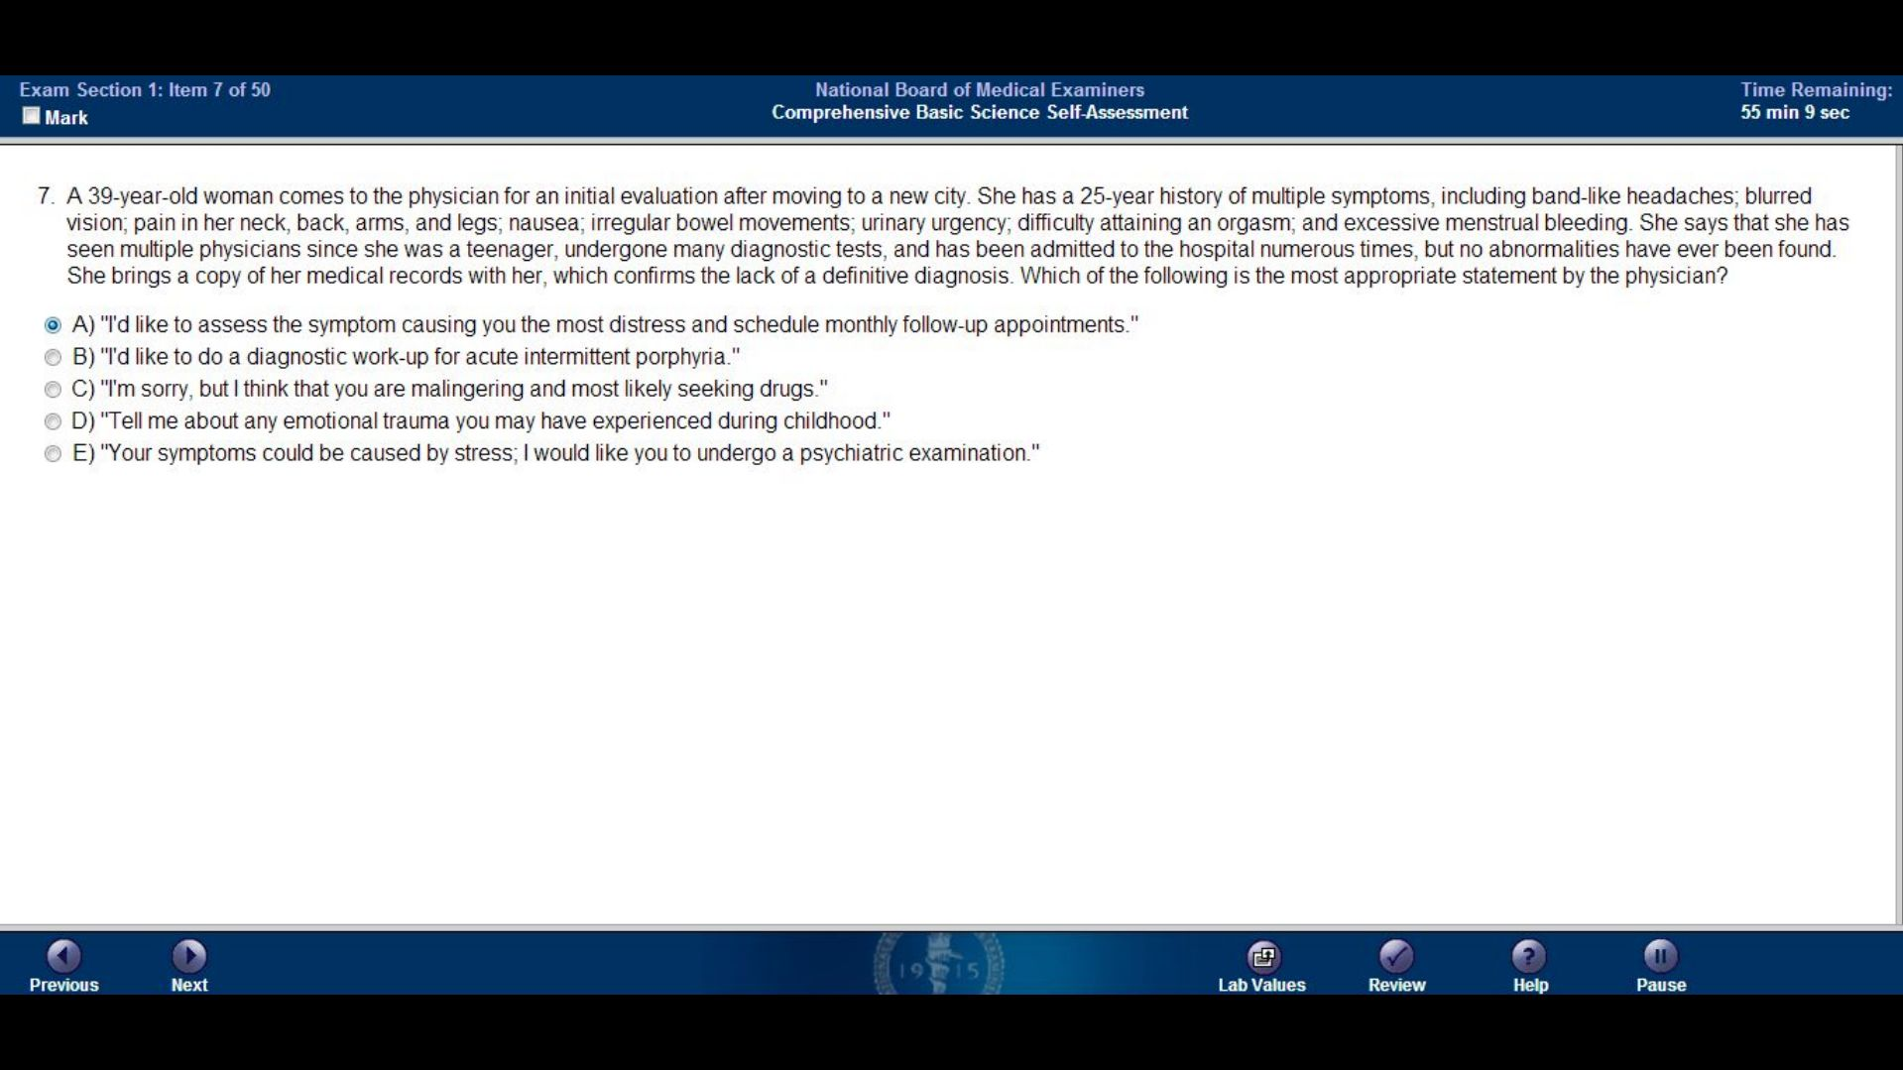

Slide 9
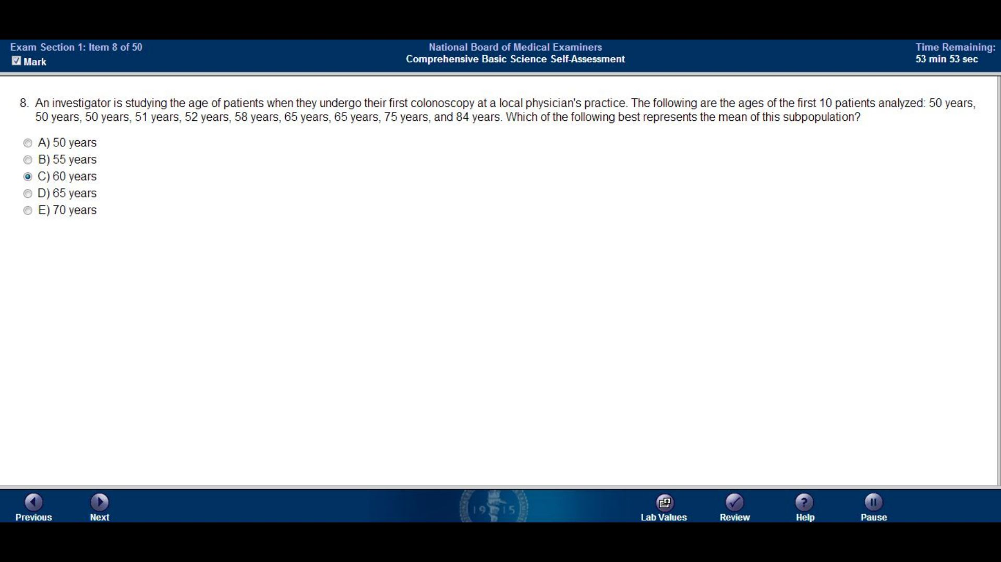

Slide 10
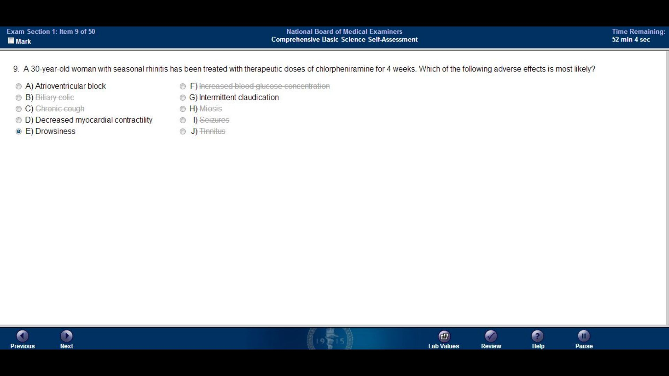
Atrioventricular block
Biliary colic
Chronic cough
Decreased myocardial contractility
Drowsiness
Increased blood glucose concentration
Intermittent claudication
Miosis
Seizures
Tinnitus

Slide 11
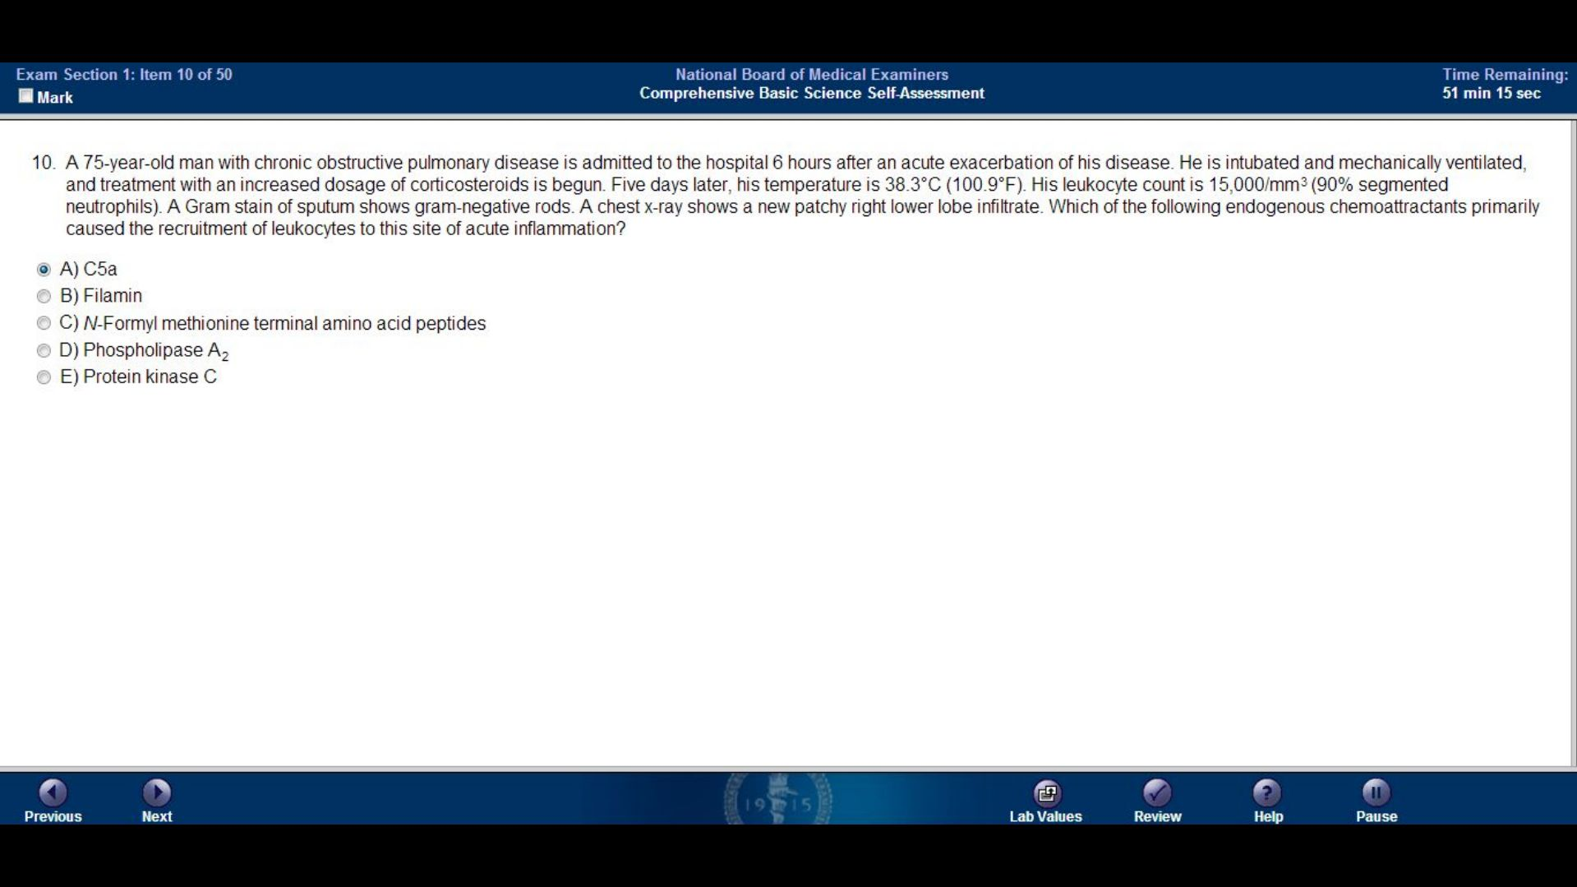

Slide 12
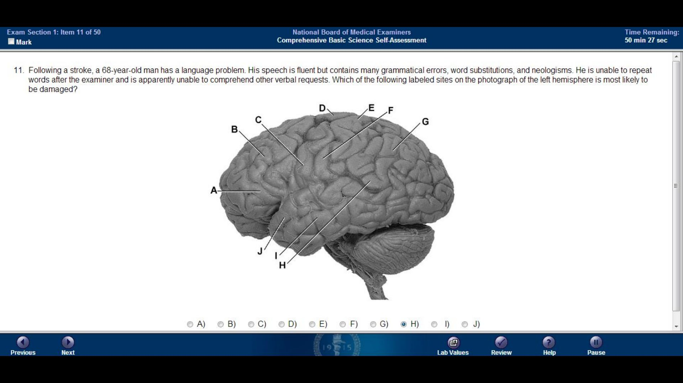

Slide 13
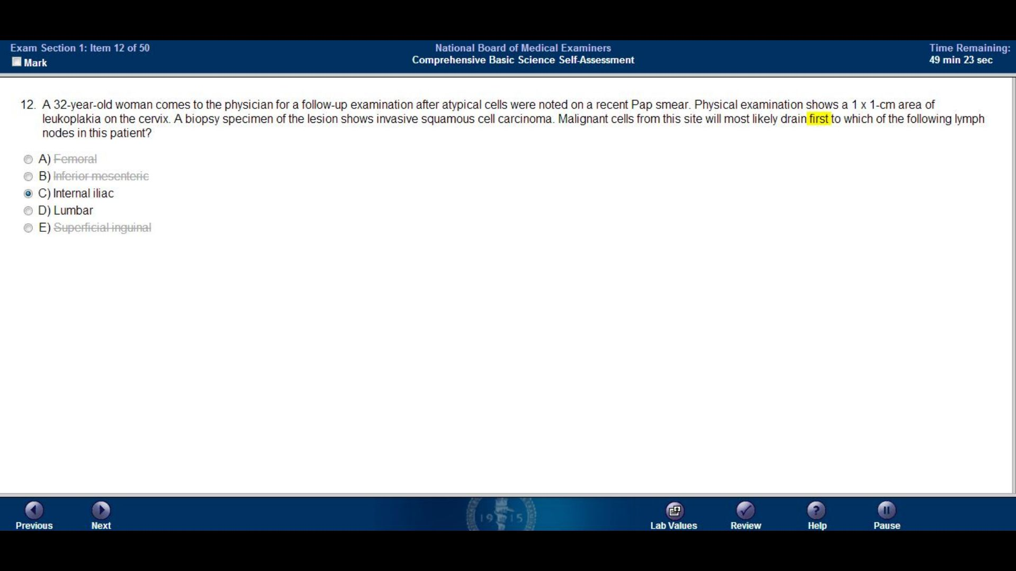
Femoral
Inferior mesenteric
Internal iliac
Lumbar
Superficial inguinal

Slide 14
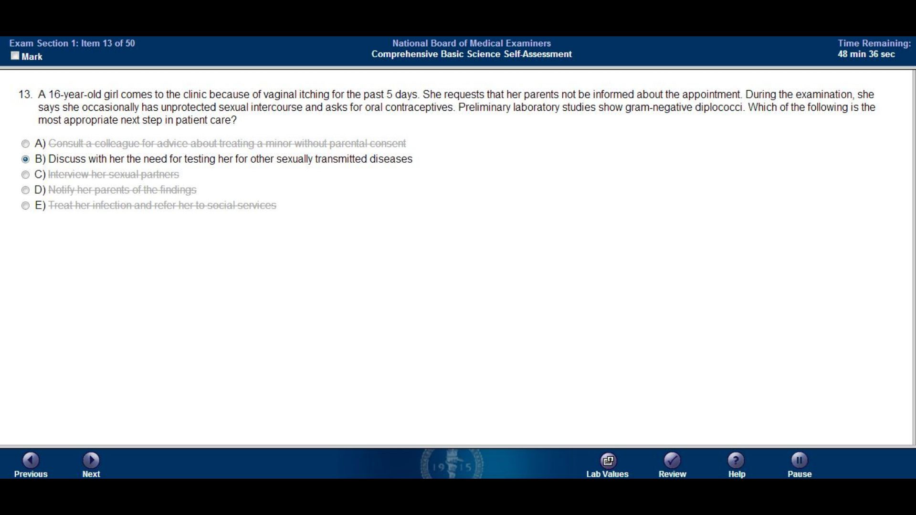
Consult a colleague for advice about treating a minor without parental consent
Discuss with her the need for testing her for other sexually transmitted diseases
Interview her sexual partners
Notify her parents of the findings
Treat her infection and refer her to social services

Slide 15
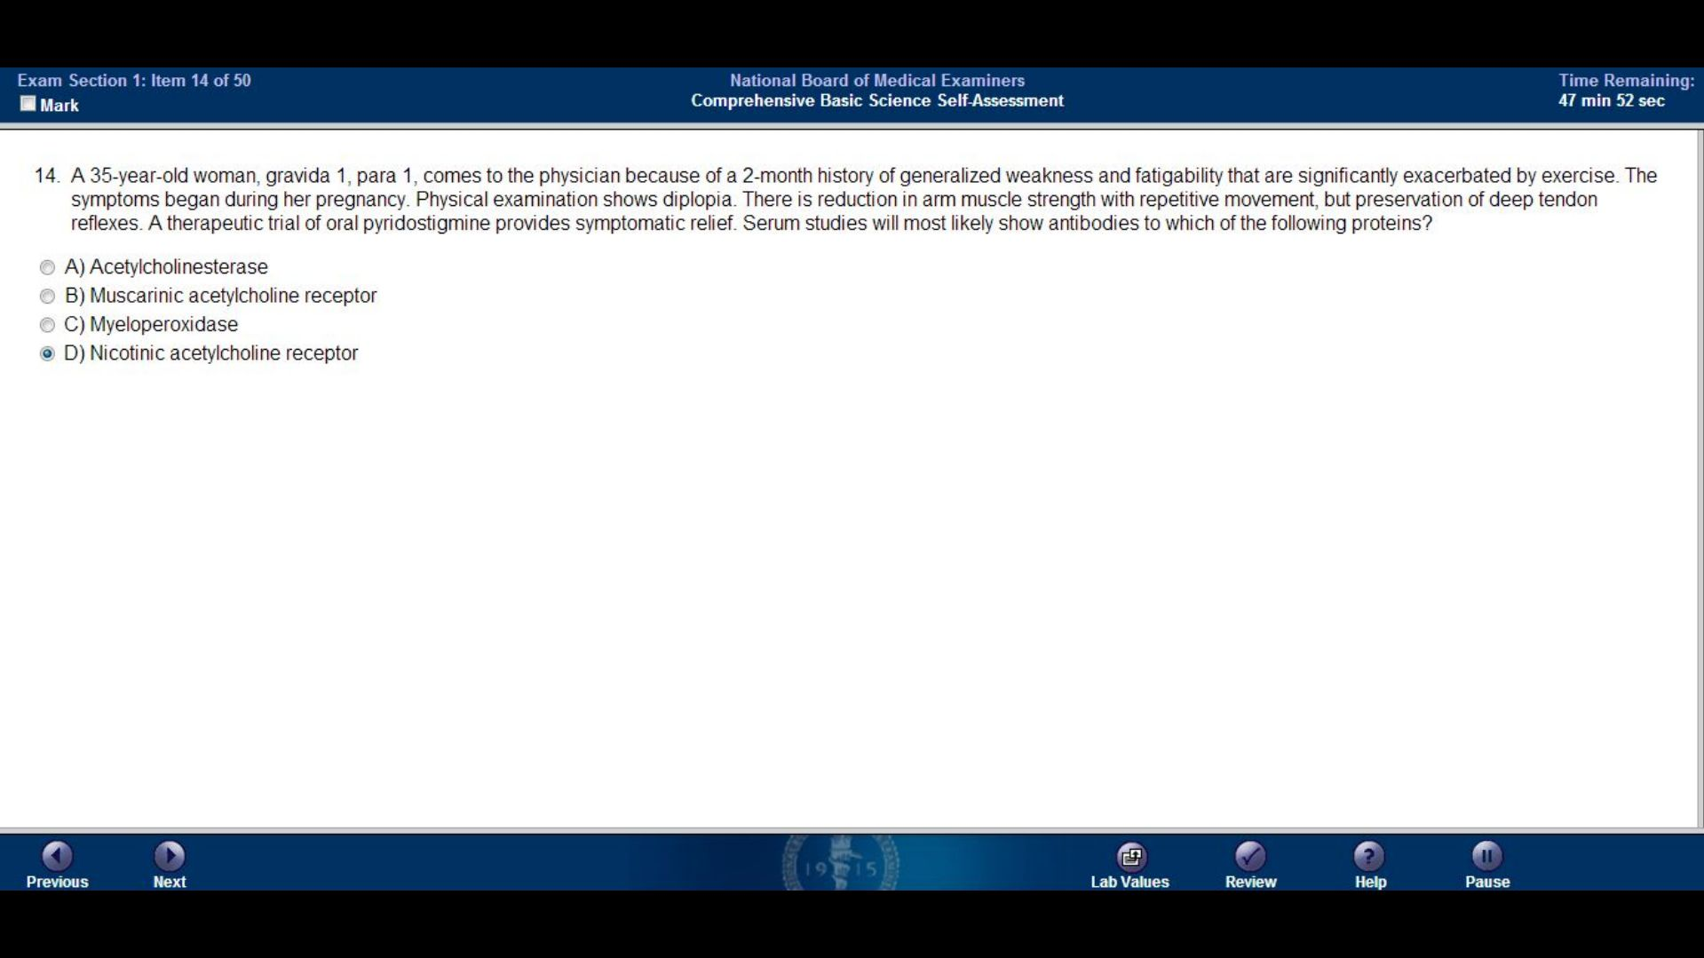

Slide 16
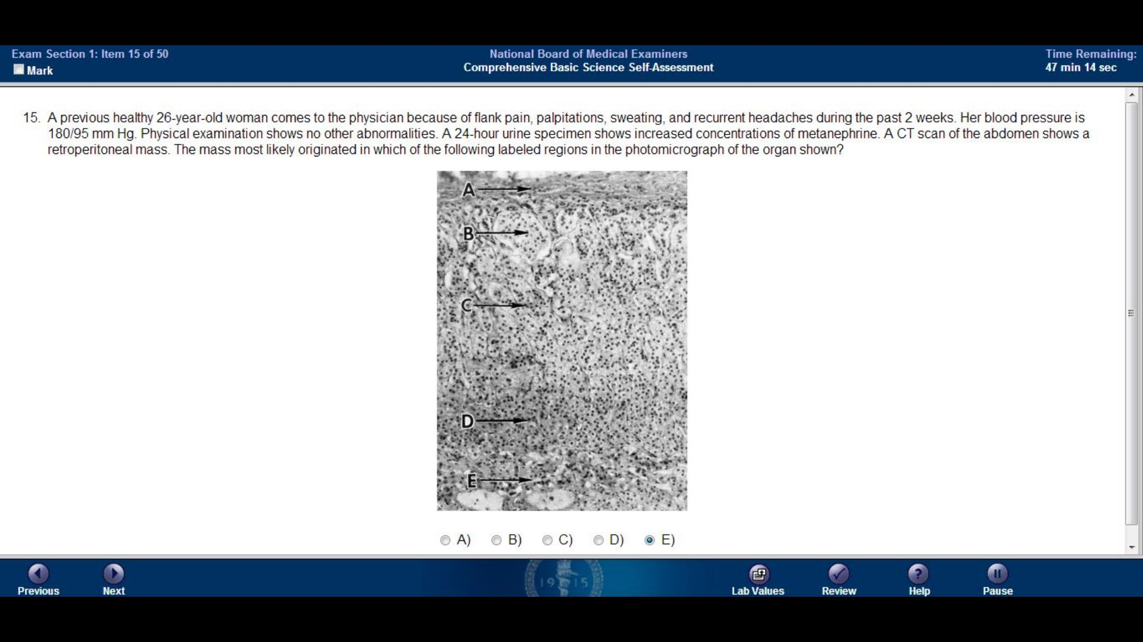

Slide 17
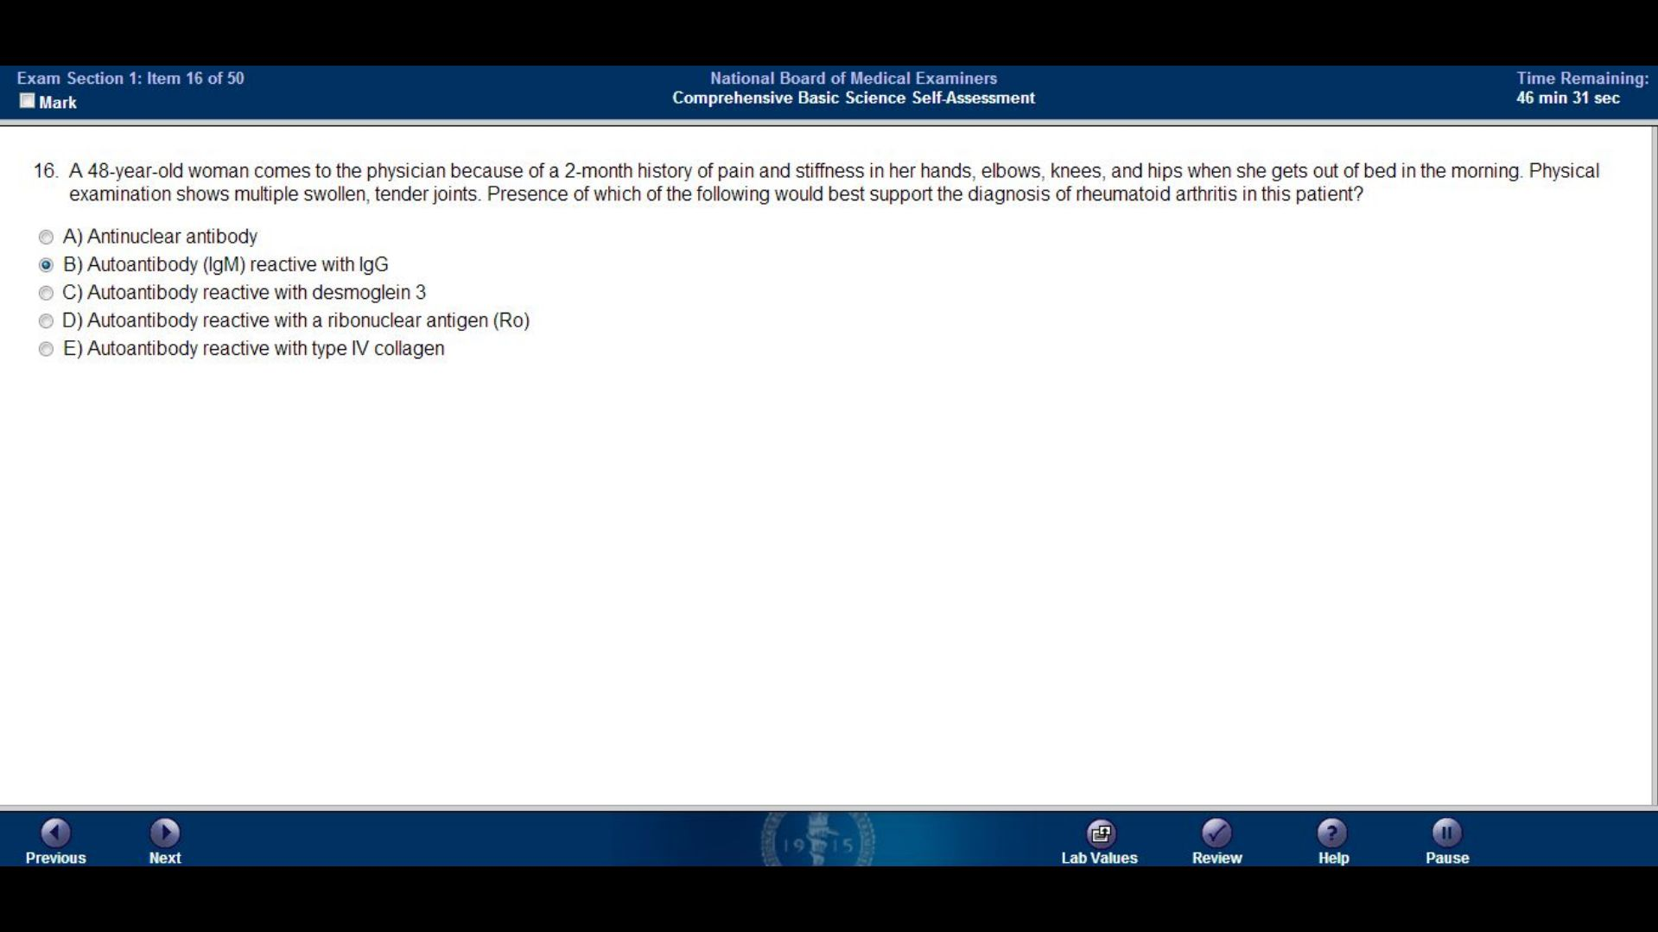

Slide 18
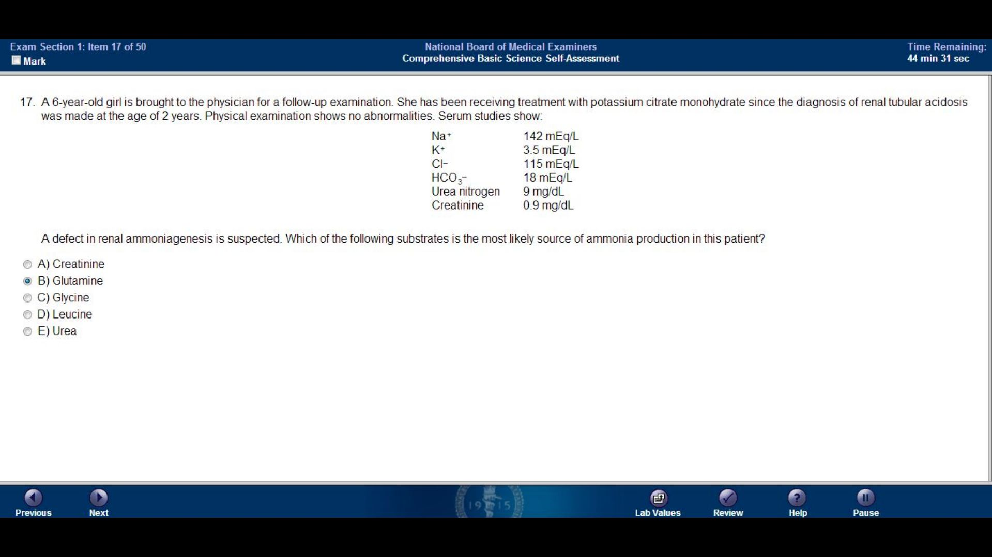

Slide 19
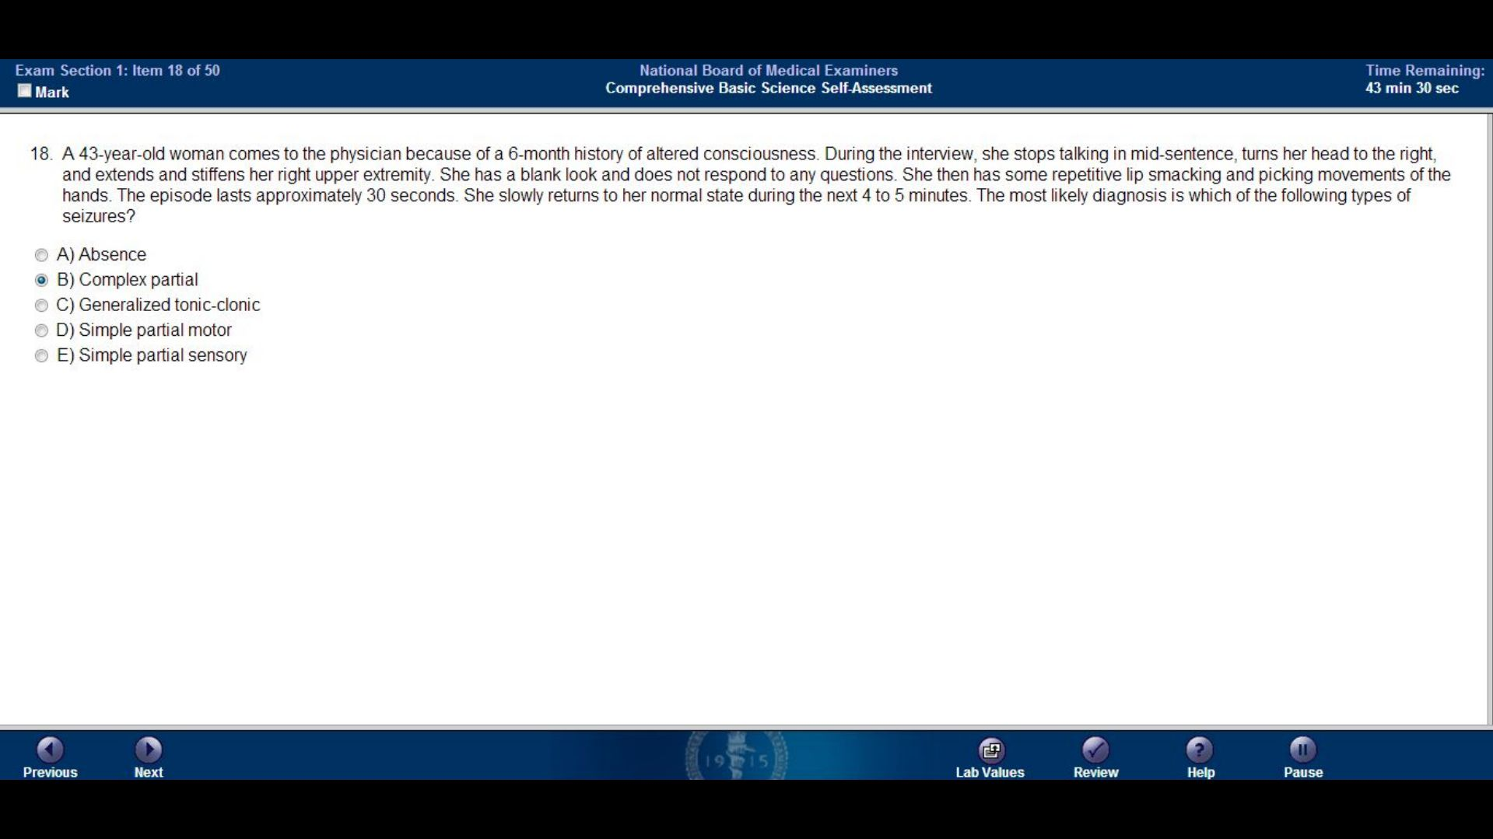

Slide 20
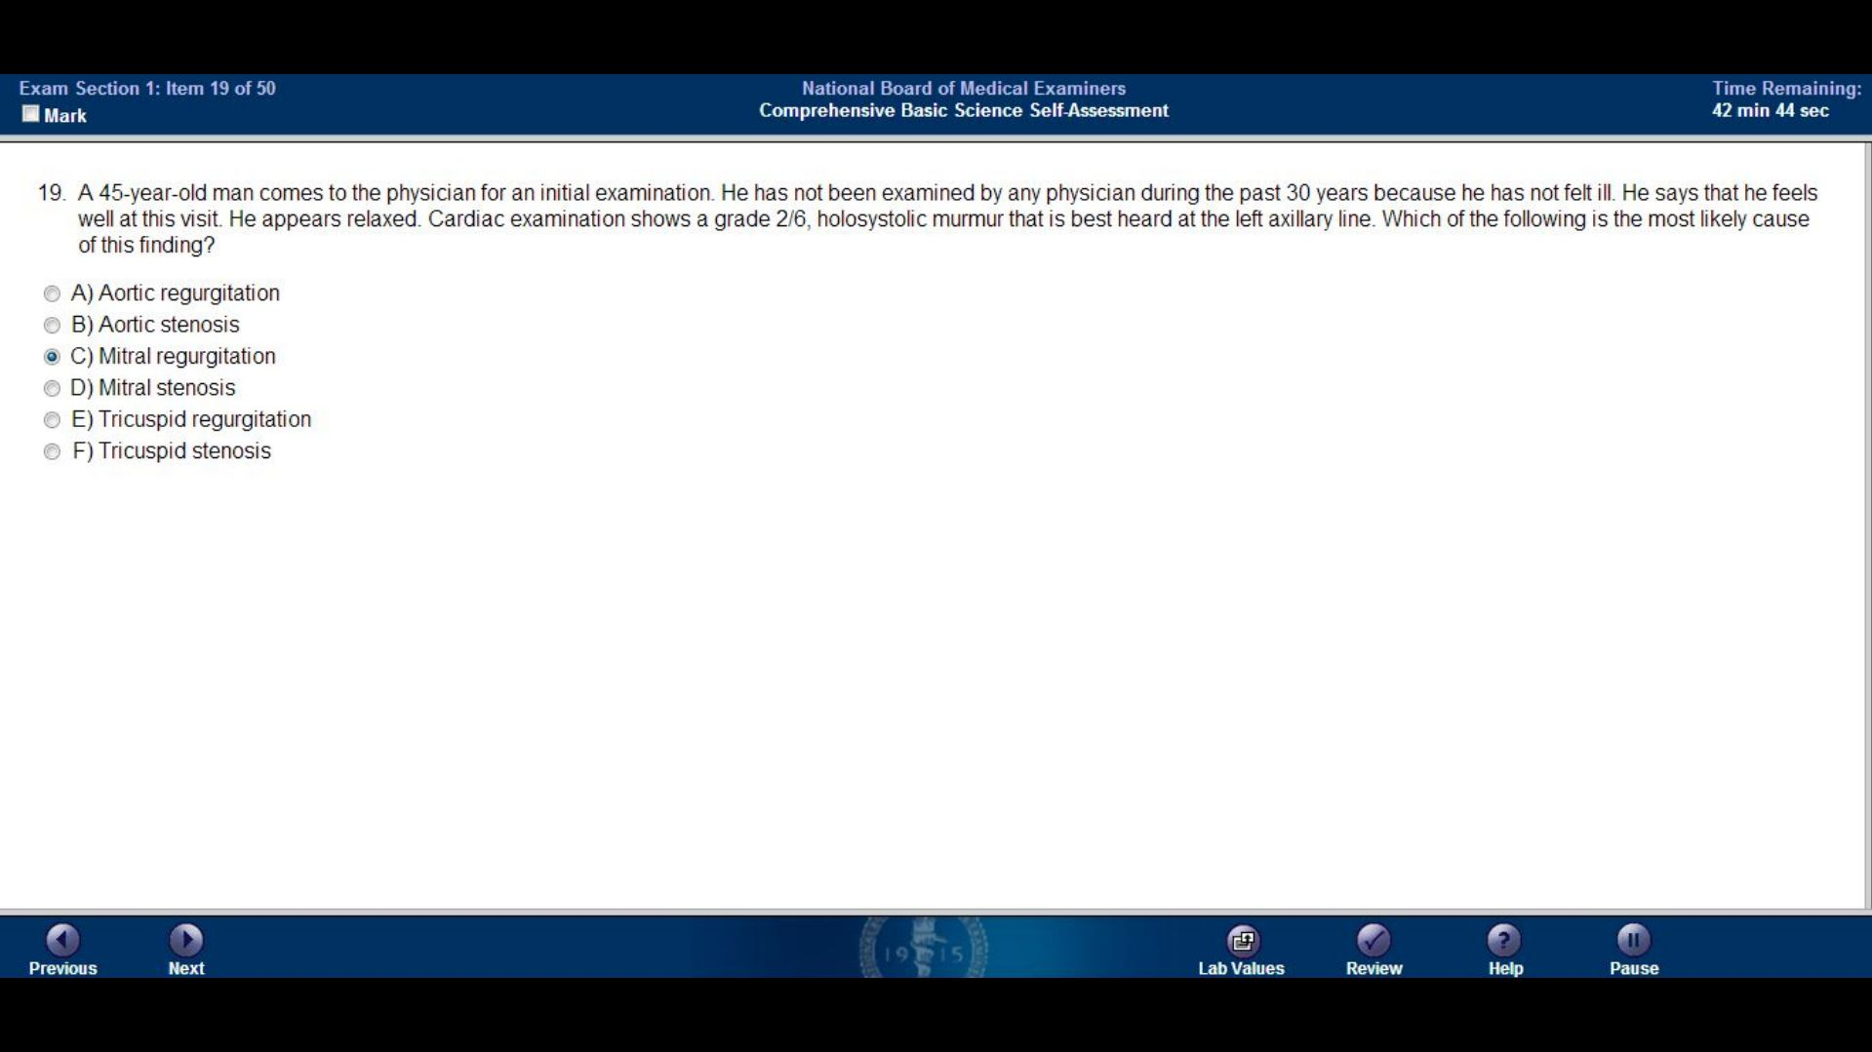

Slide 21
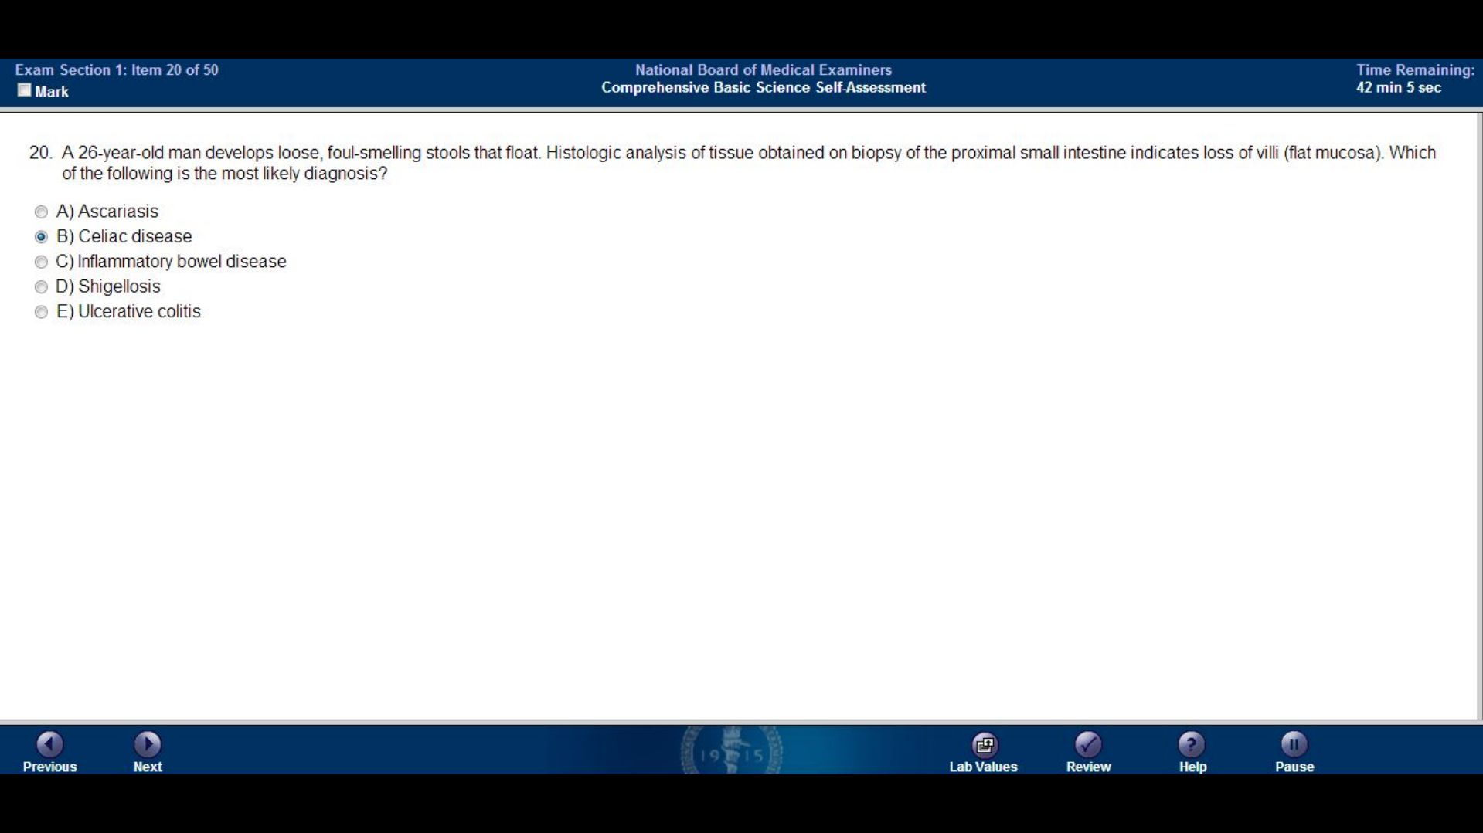

Slide 22
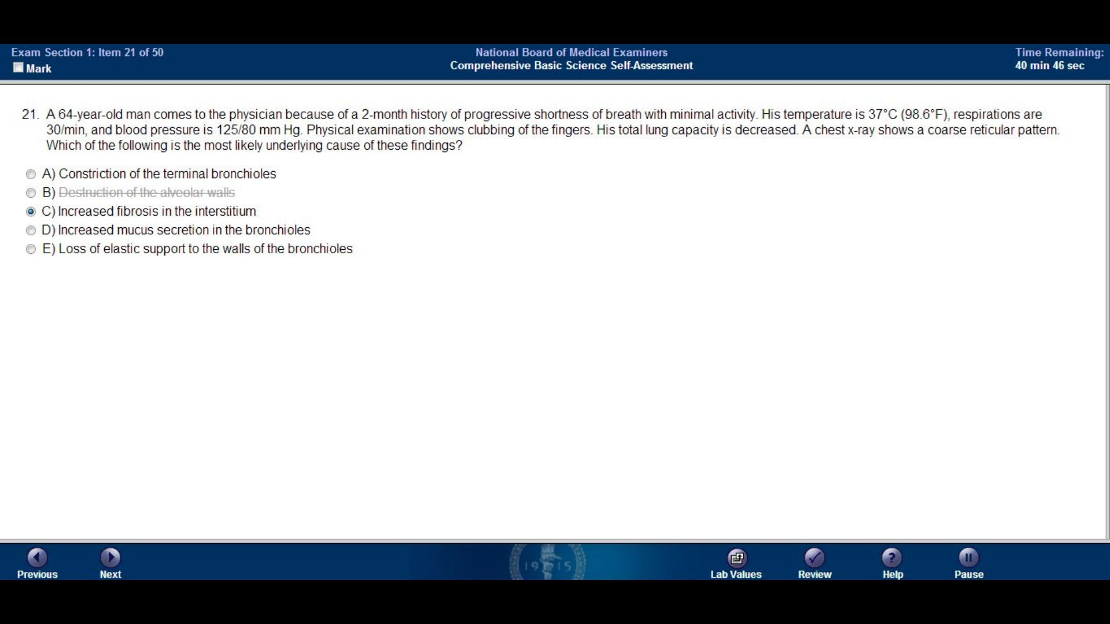
Constriction of the terminal bronchioles
Destruction of the alveolar walls
Increased fibrosis in the interstitium
Increased mucus secretion in the bronchioles
Loss of elastic support to the walls of the bronchioles

Slide 23
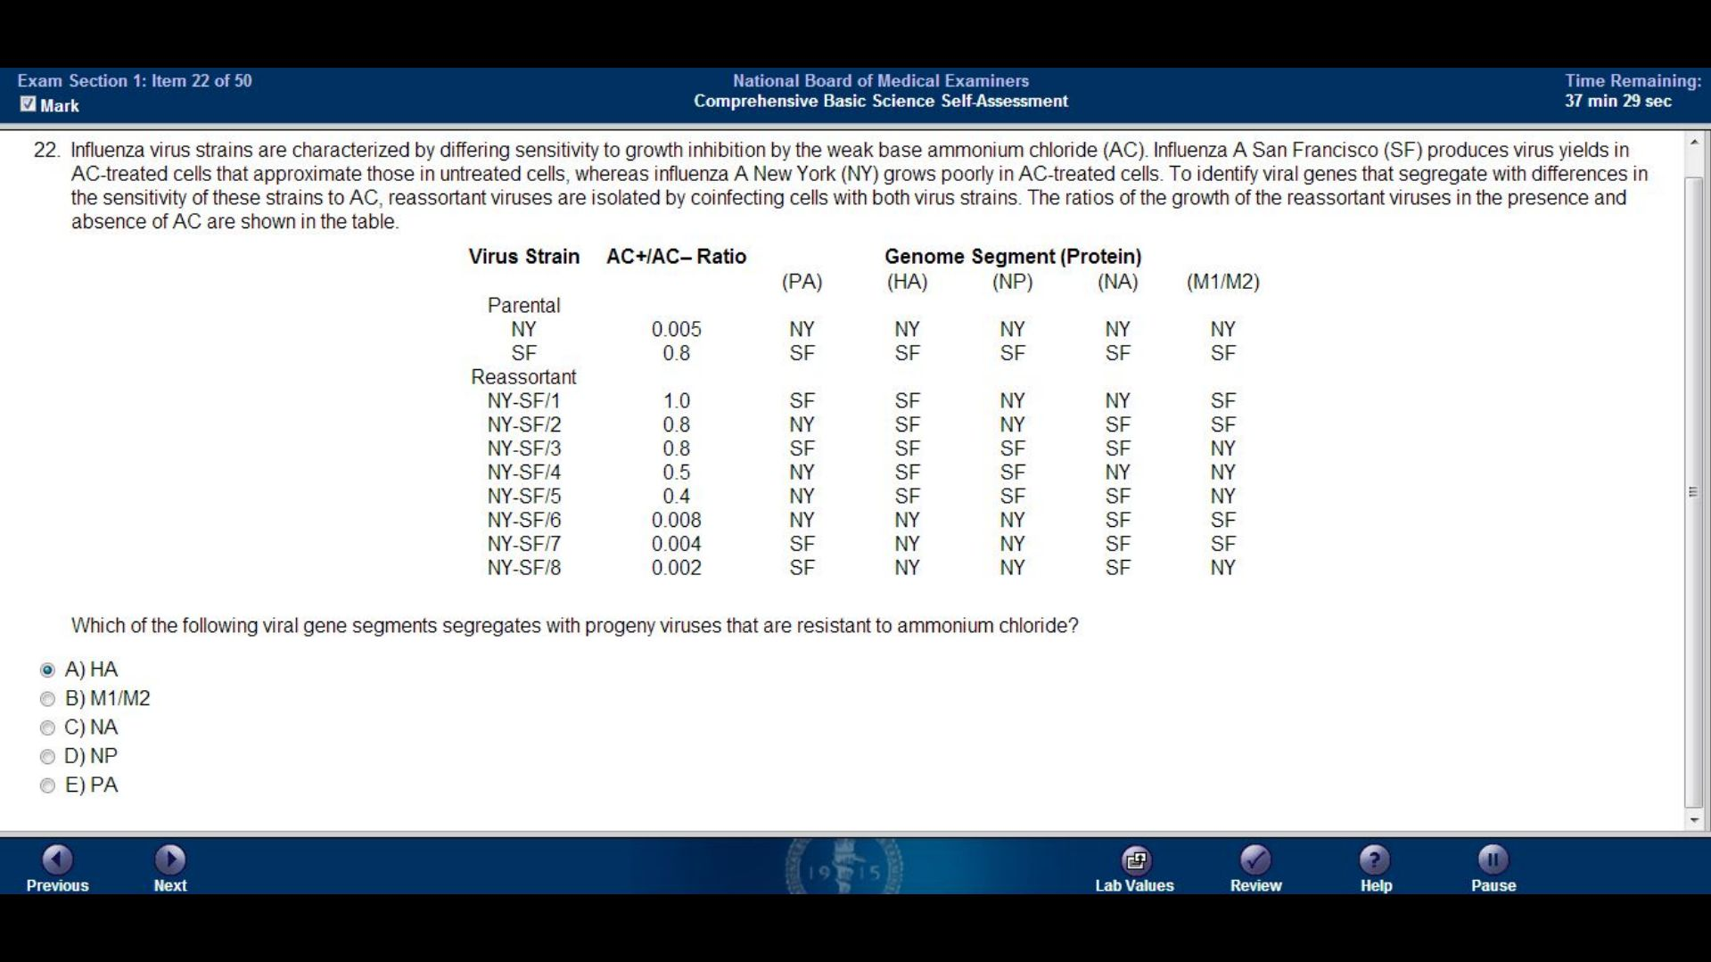

Slide 24
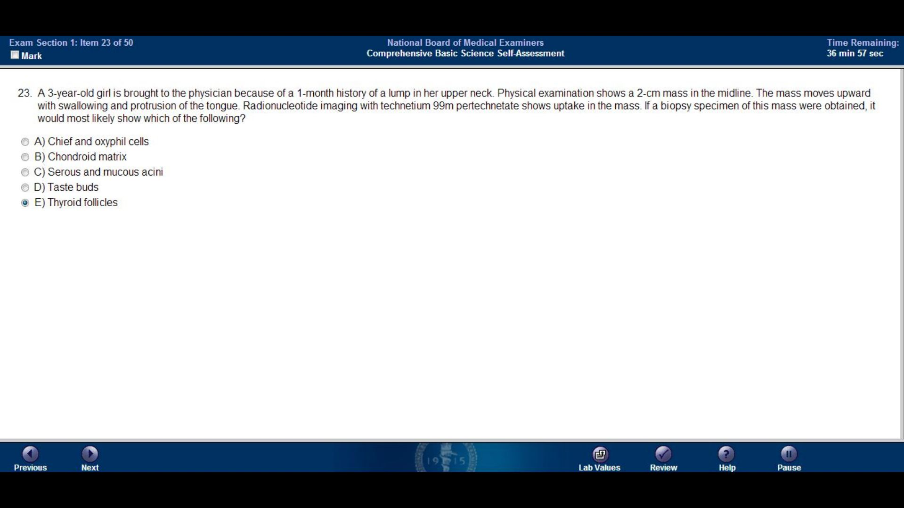

Slide 25
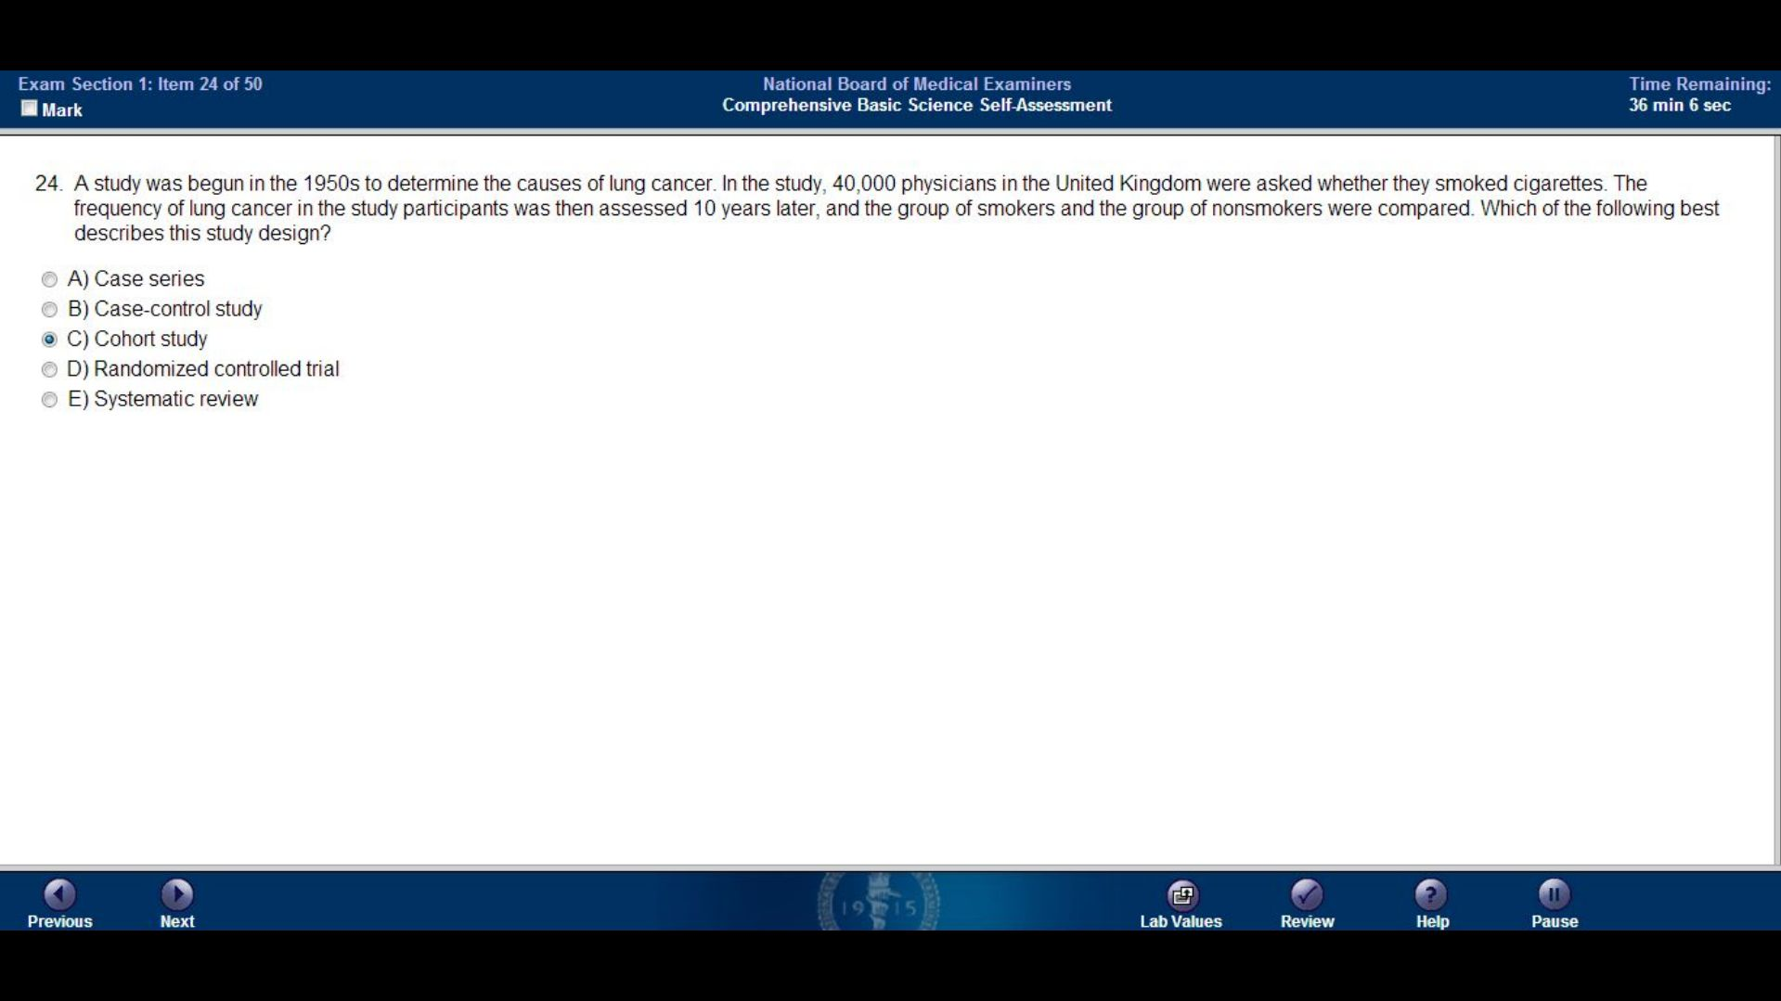

Slide 26
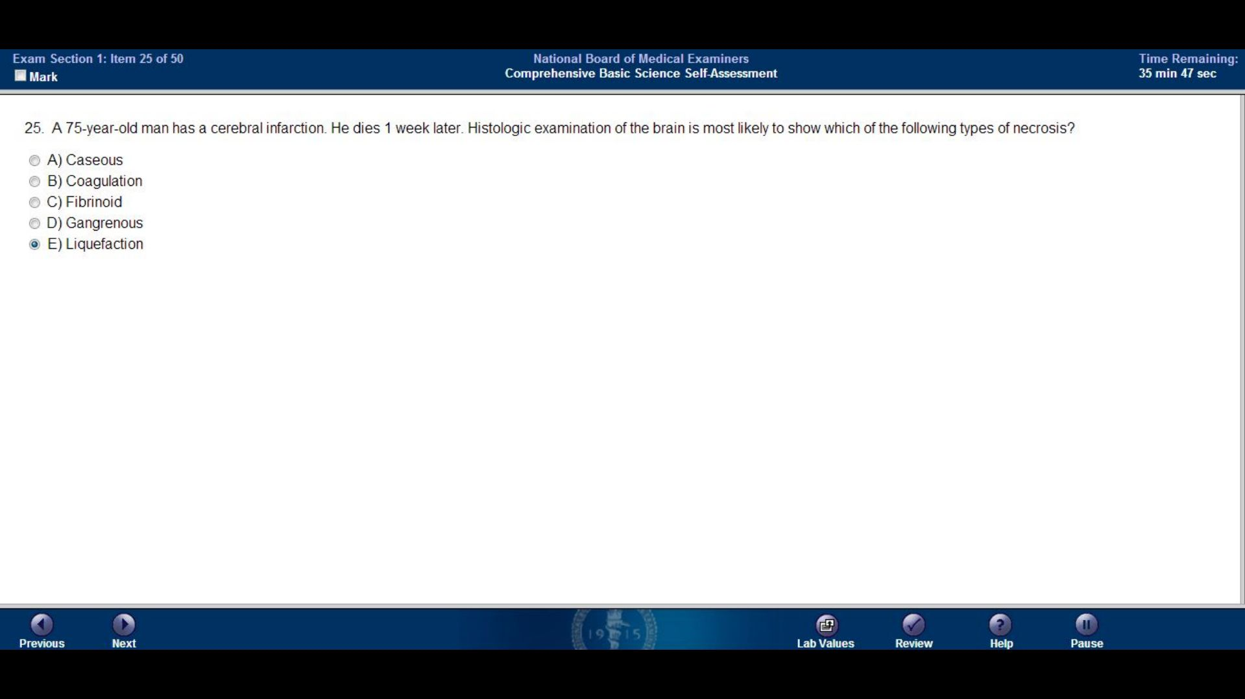

Slide 27
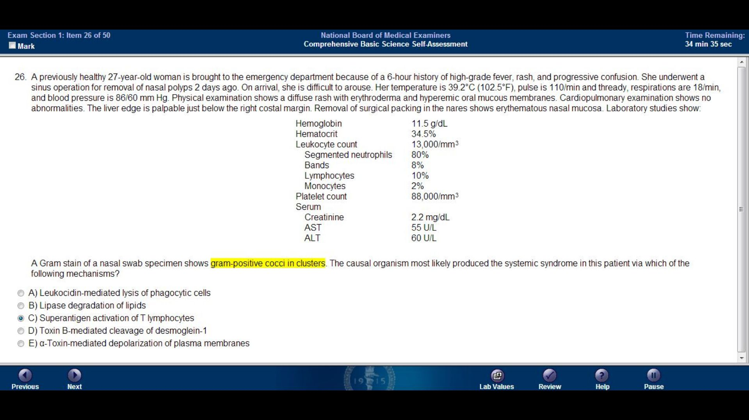

Slide 28
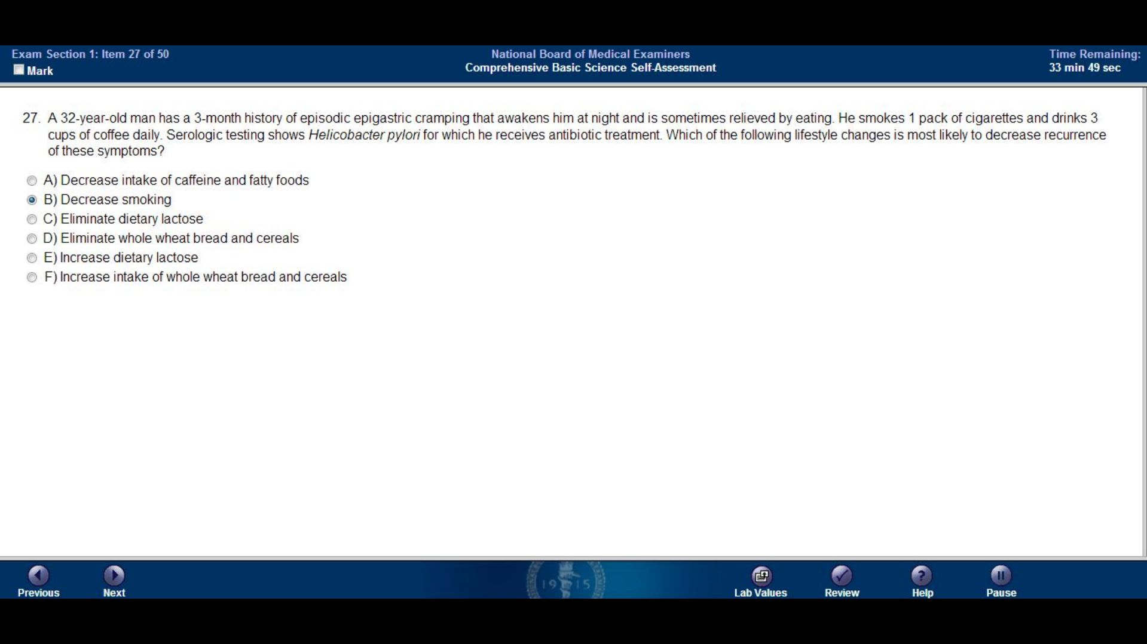

Slide 29
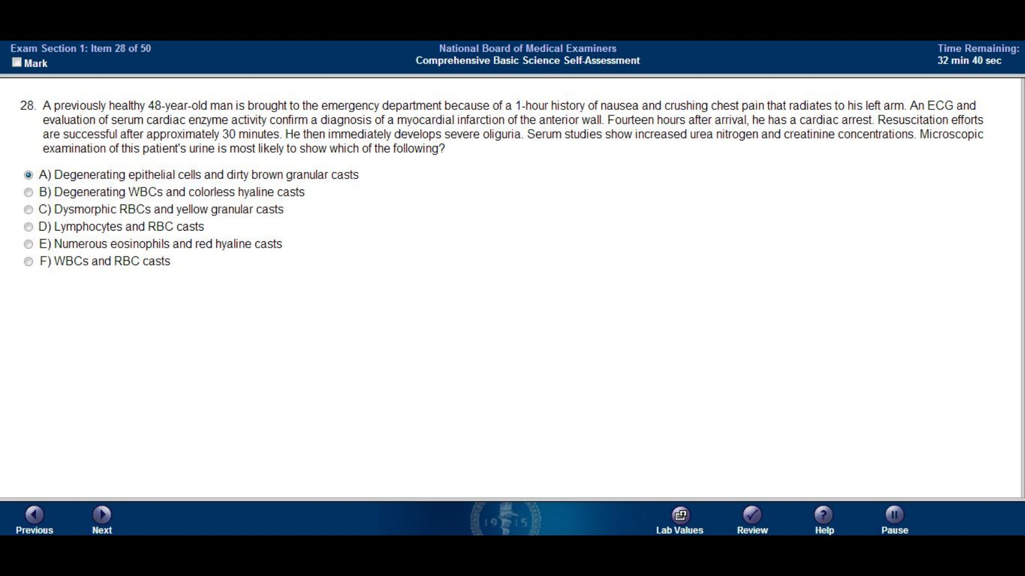

Slide 30
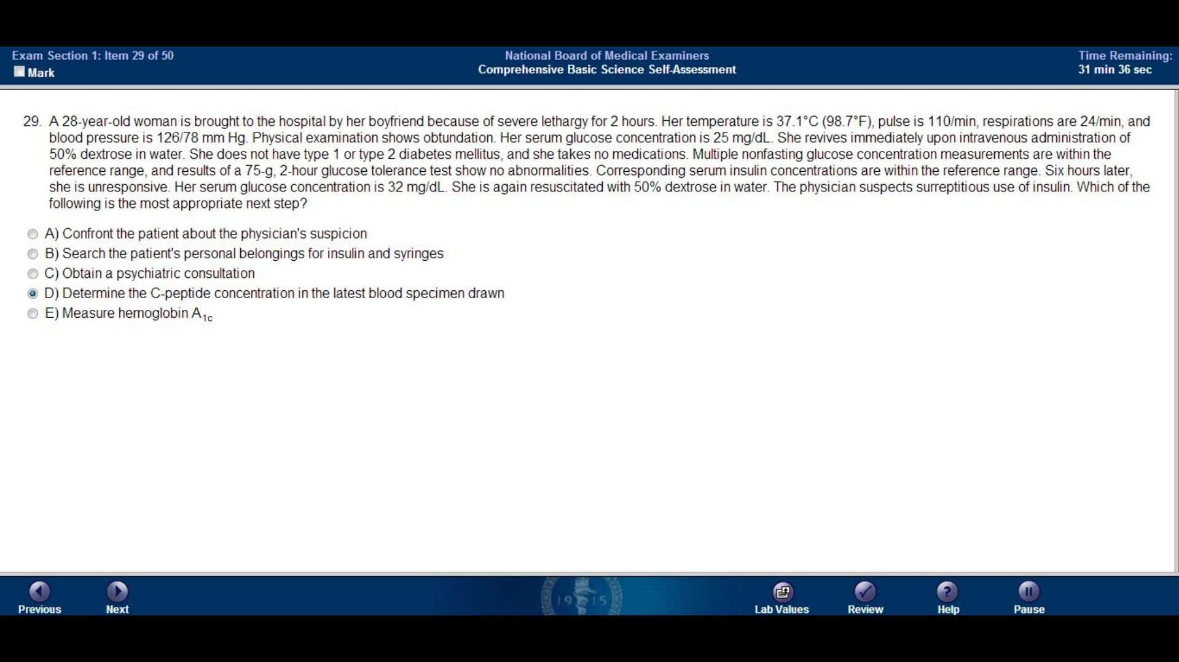

Slide 31
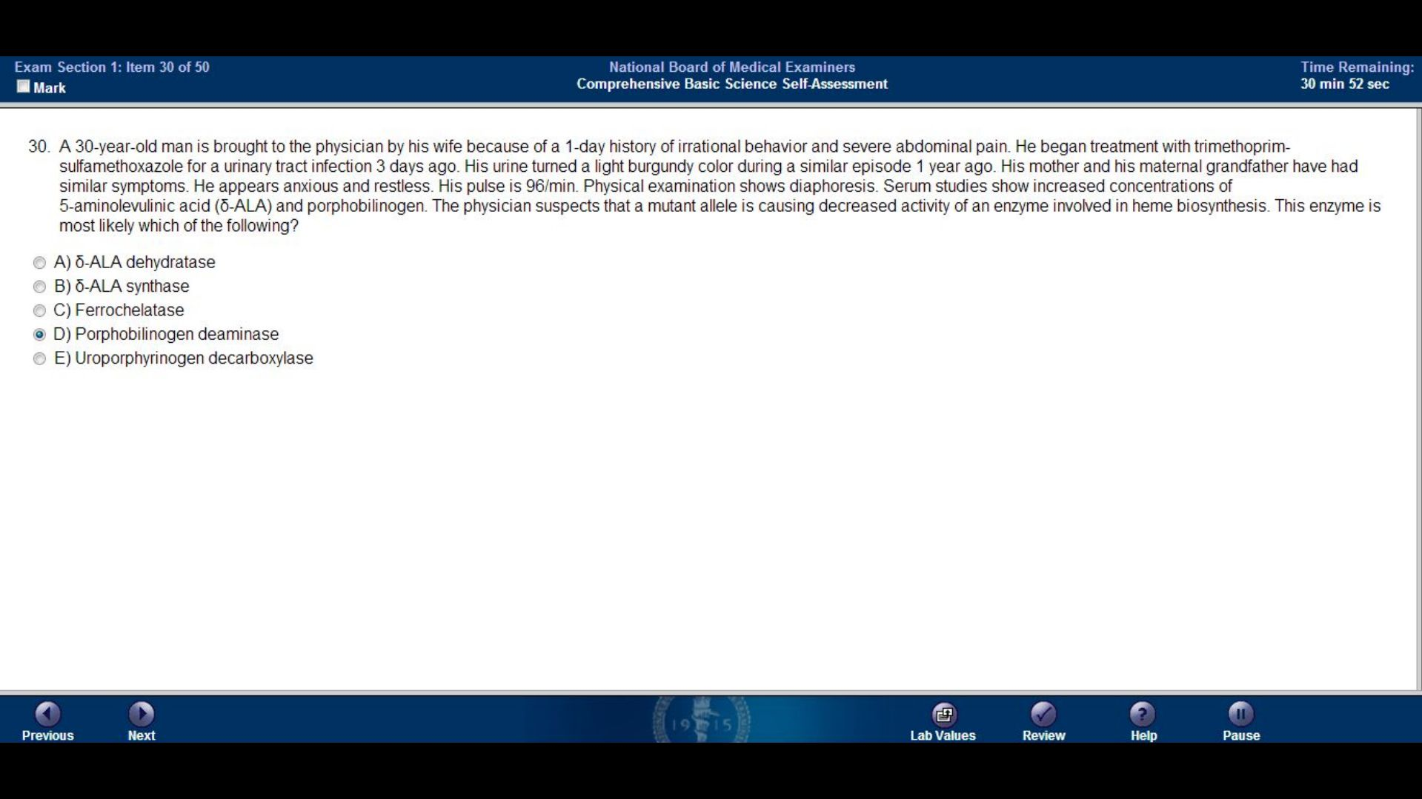

Slide 32
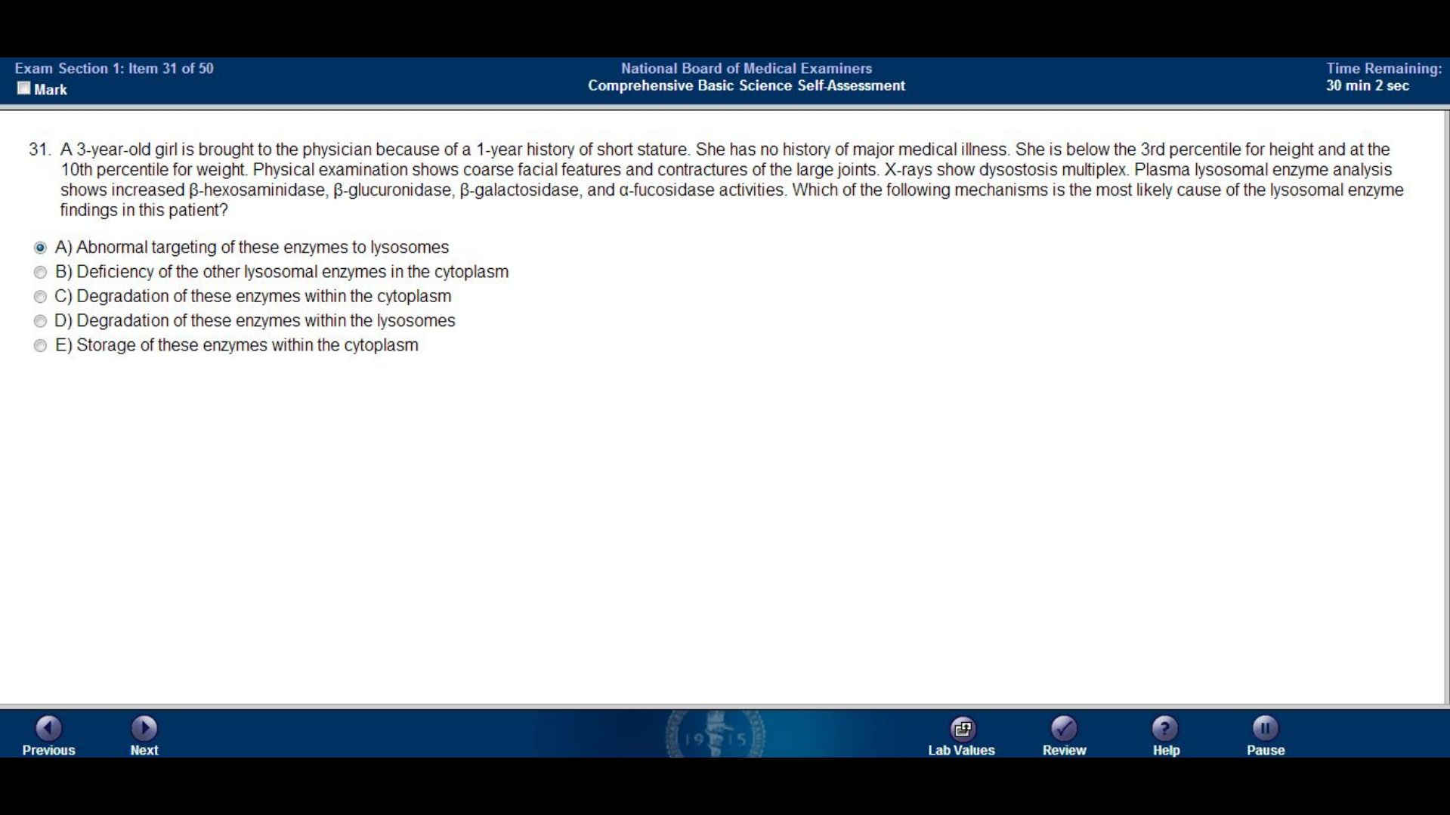

Slide 33
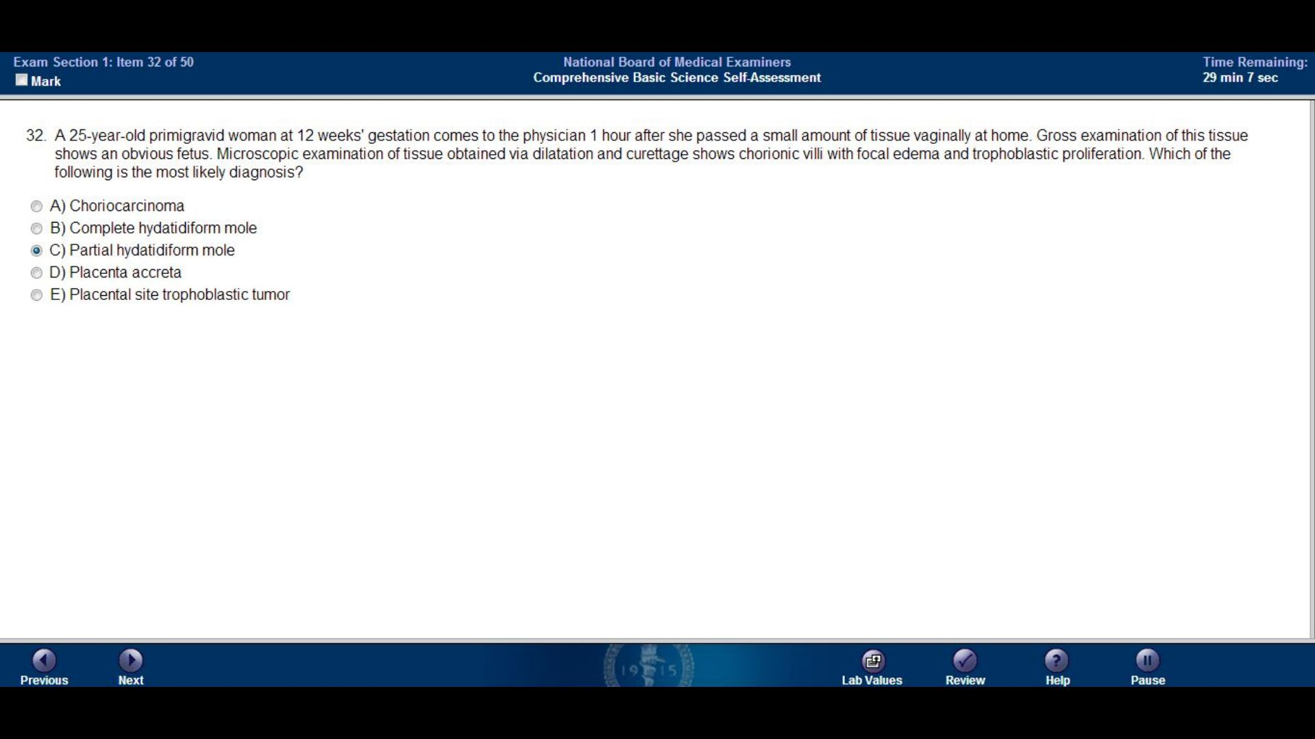

Slide 34
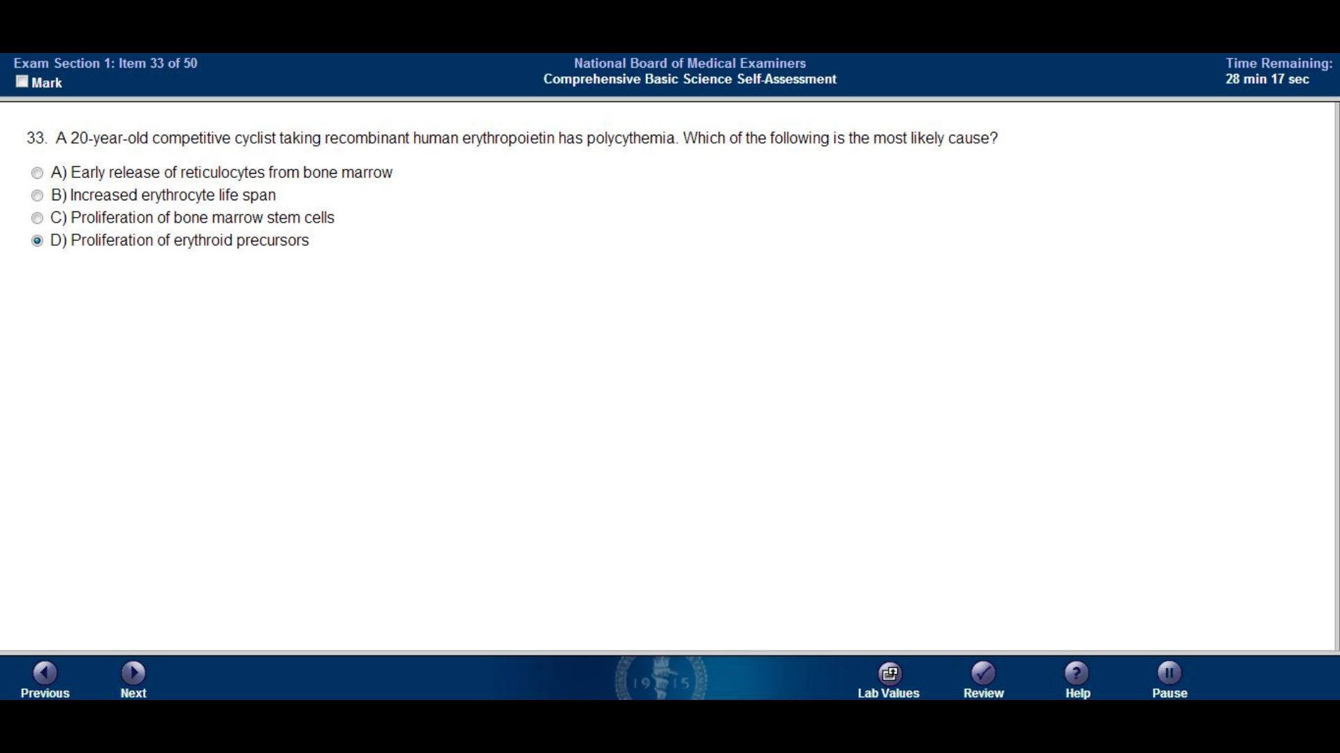

Slide 35
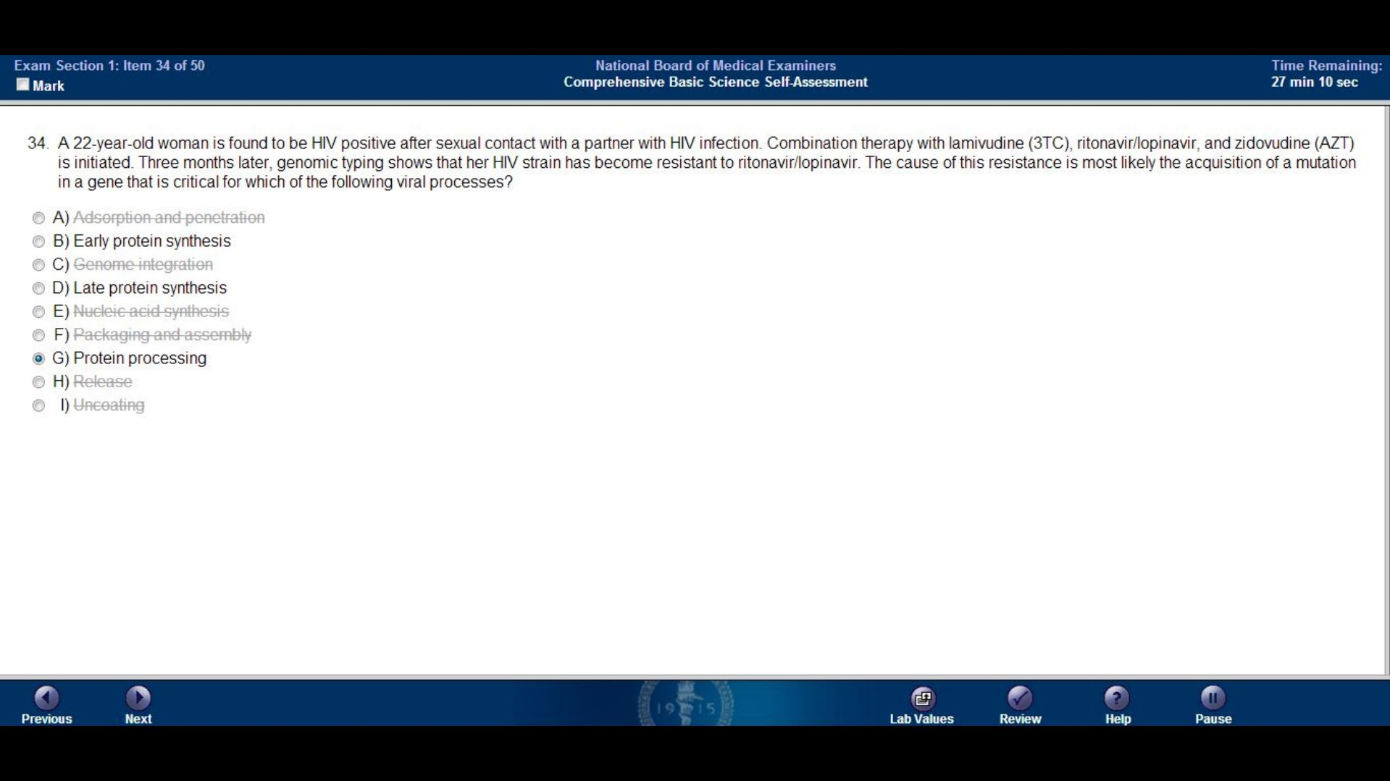
Adsorption and penetration
Early protein synthesis
Genome integration
Late protein synthesis
Nucleic acid synthesis
Packaging and assembly
Protein processing
Release
Uncoating

Slide 36
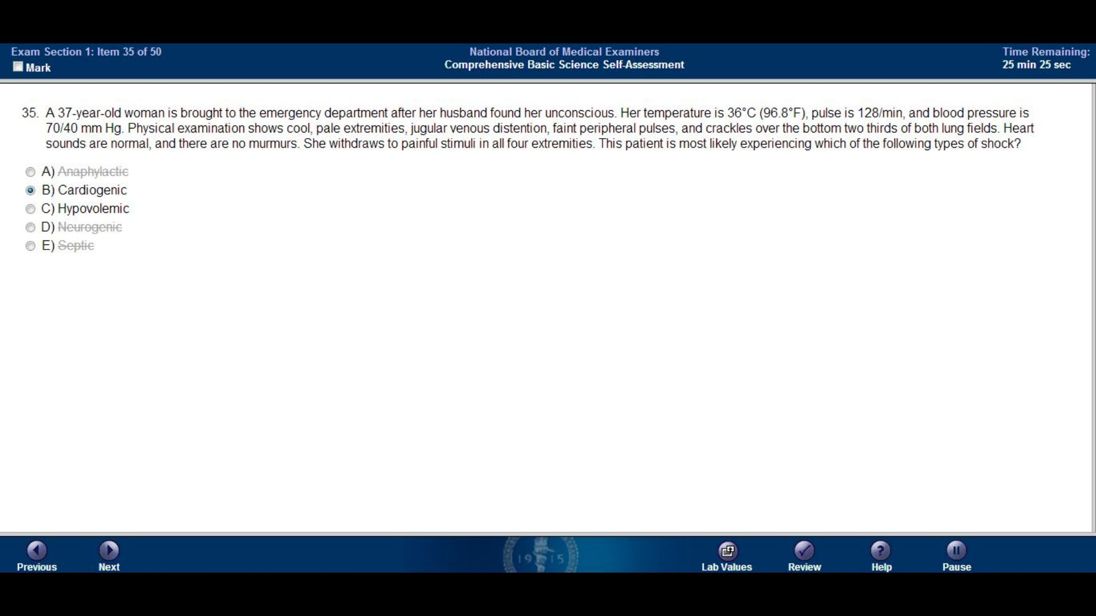
Anaphylactic
Cardiogenic
Hypovolemic
Neurogenic
Septic

Slide 37
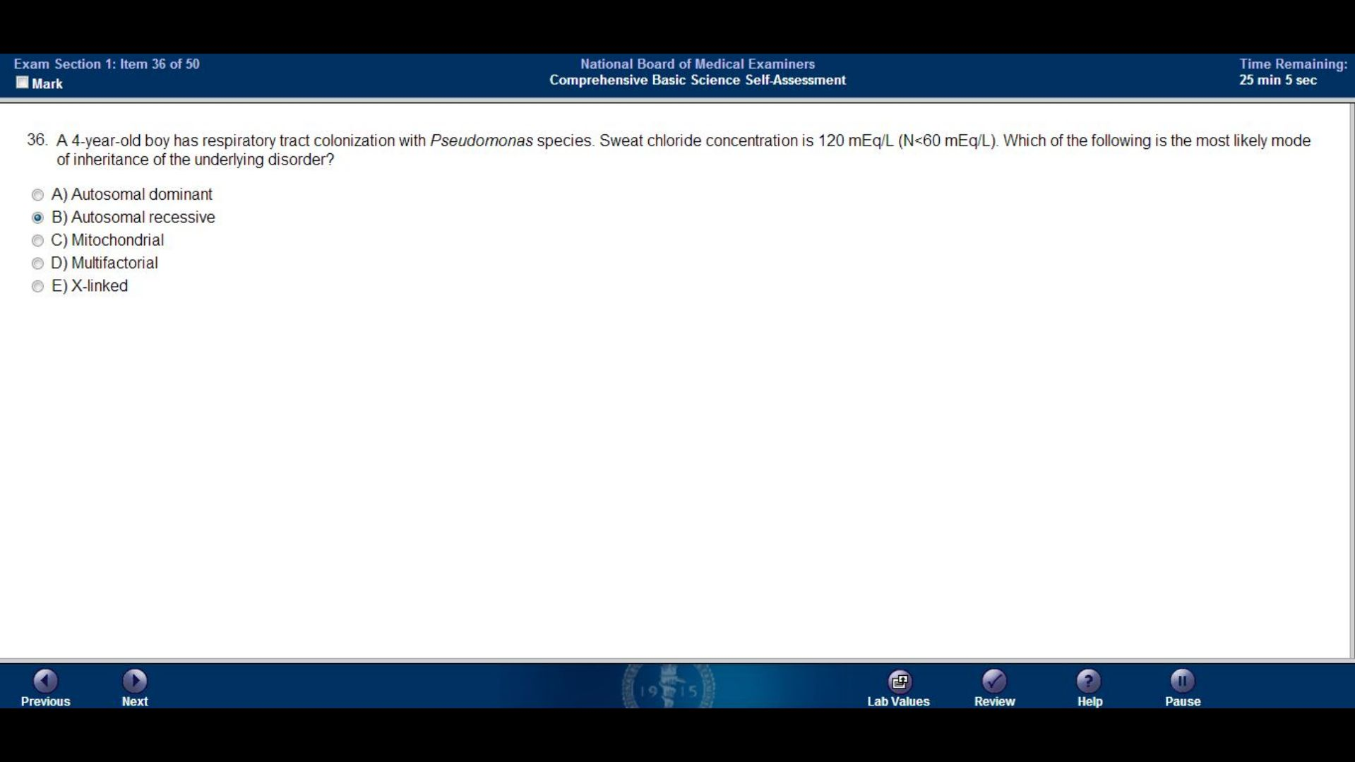

Slide 38
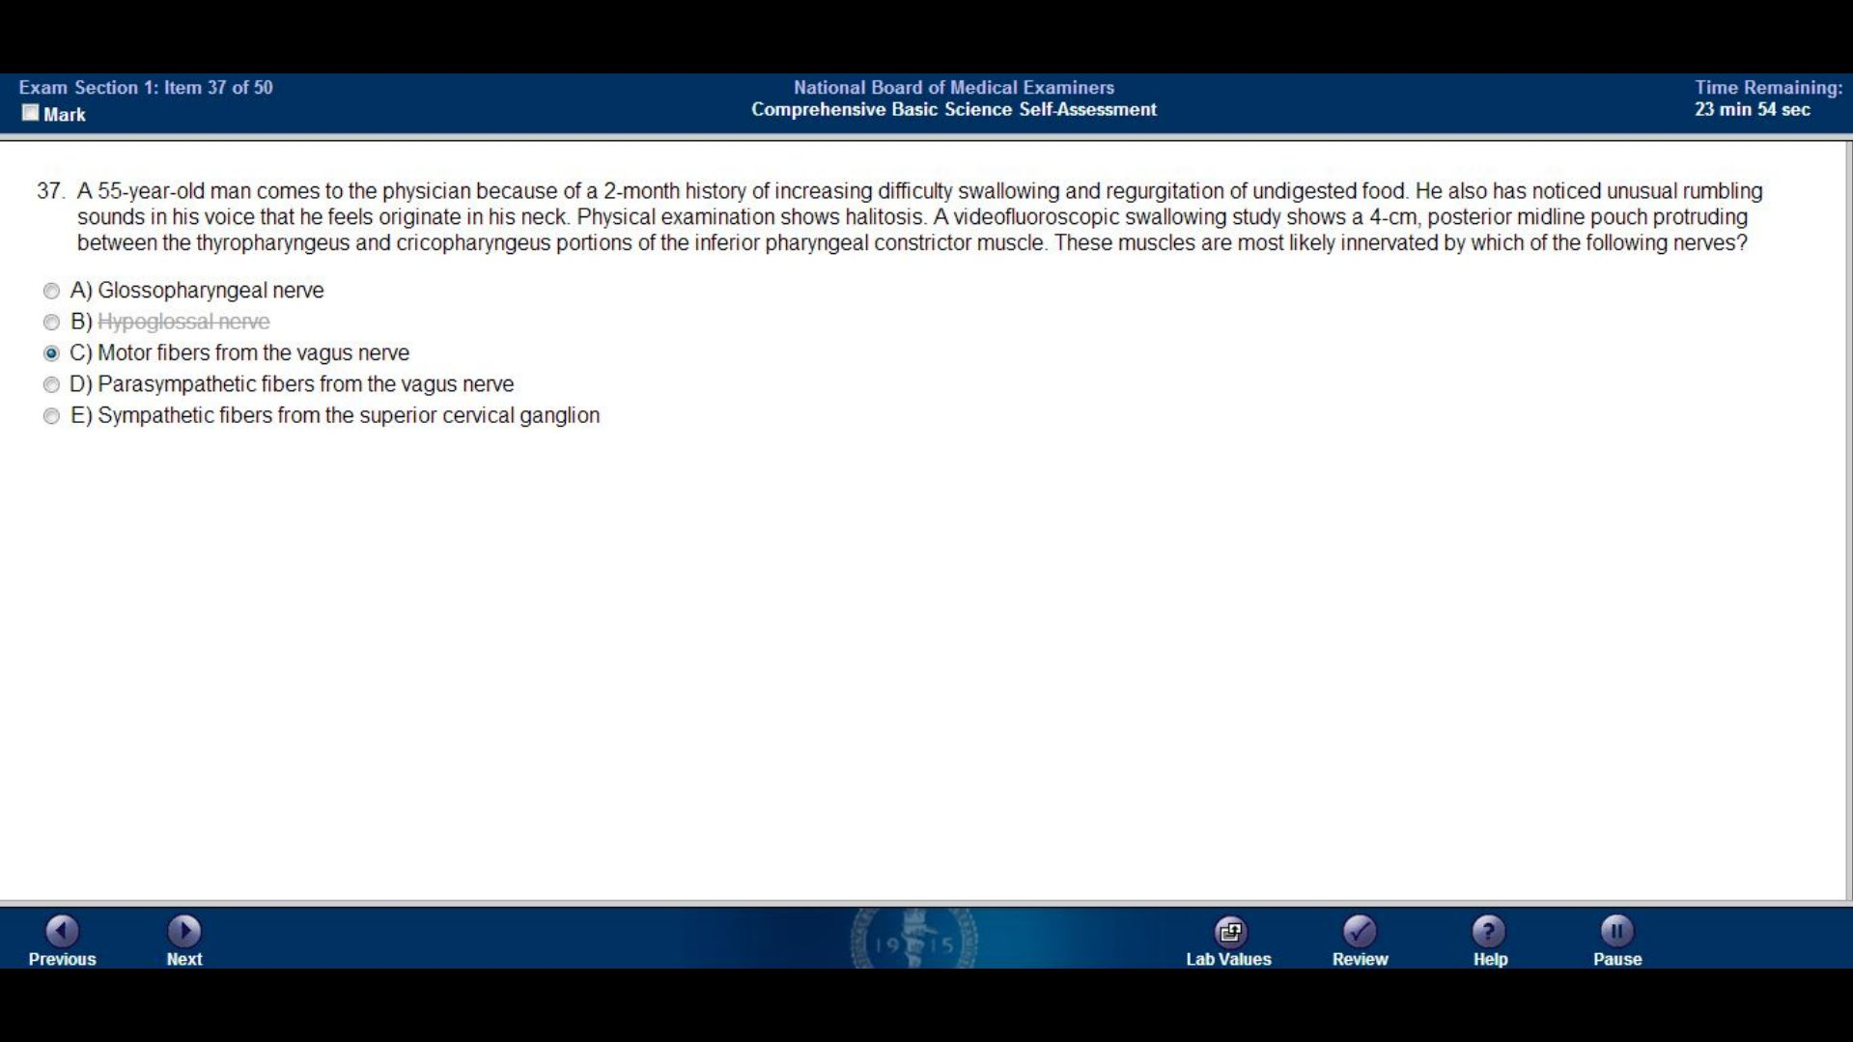
Glossopharyngeal nerve
Hypoglossal nerve
Motor fibers from the vagus nerve
Parasympathetic fibers from the vagus nerve
Sympathetic fibers from the superior cervical ganglion

Slide 39
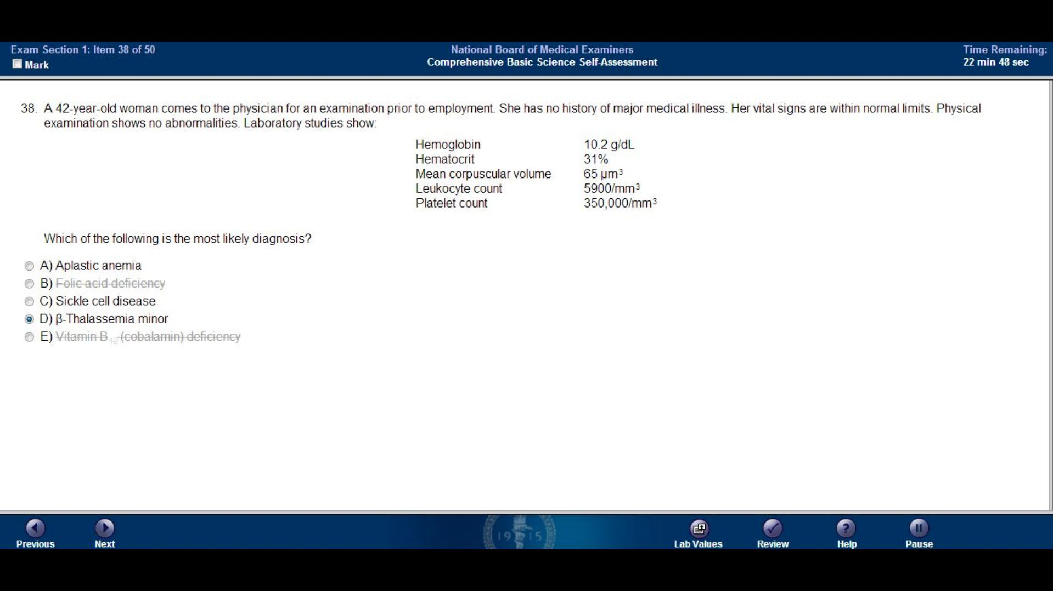
Aplastic anemia
Folic acid deficiency
Sickle cell disease
Beta-Thalassemia minor
Vitamin B12 (cobalamin) deficiency

Slide 40
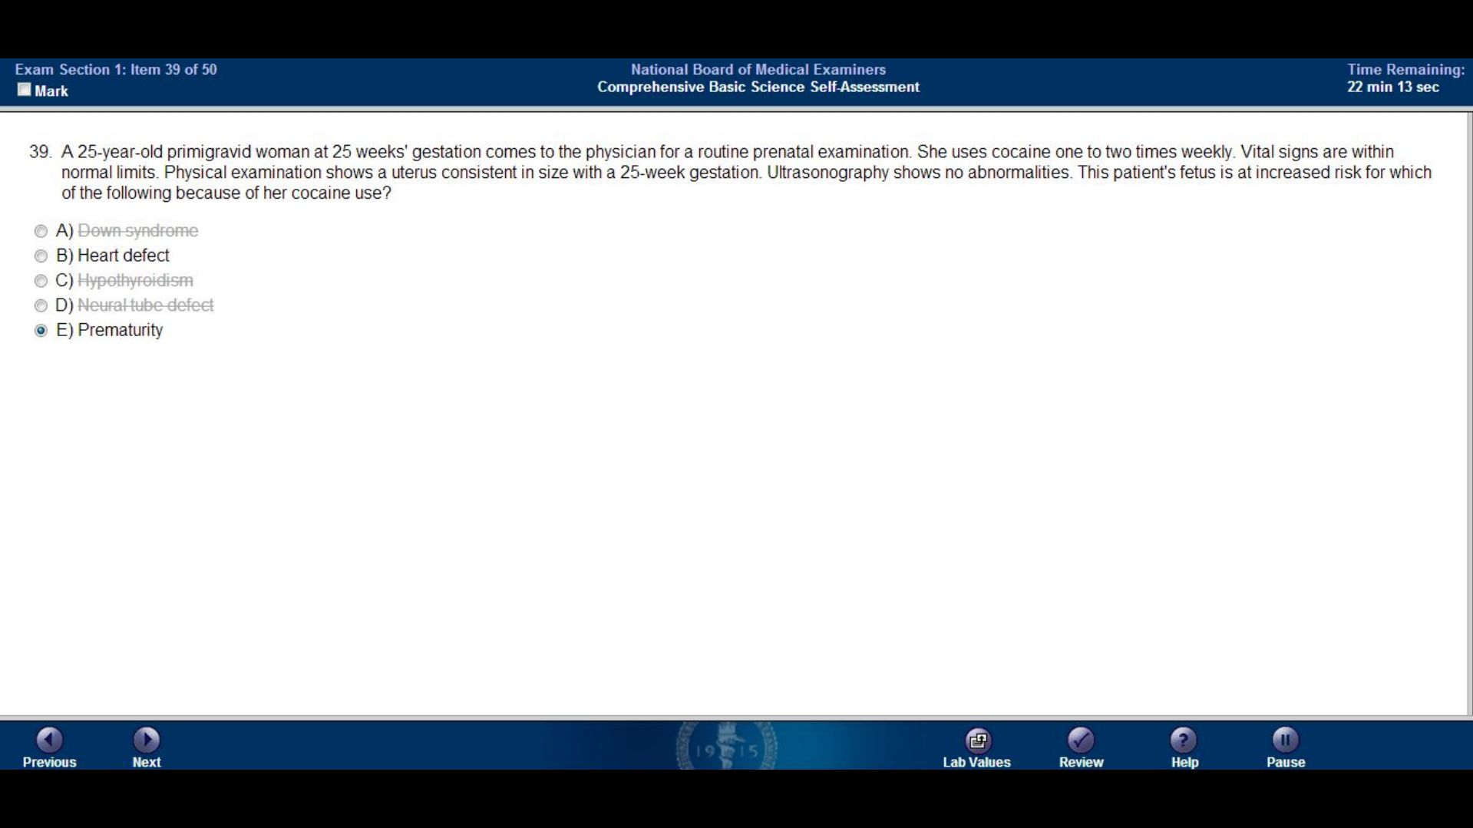
Down syndrome
Heart defect
Hypothyroidism
Neural tube defect
Prematurity

Slide 41
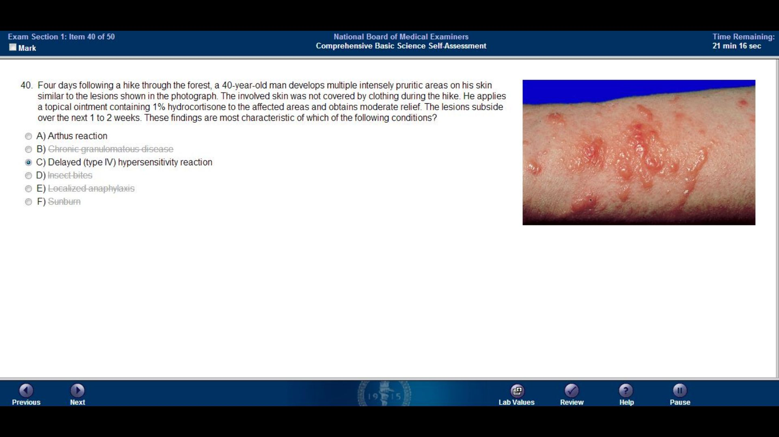
Arthus reaction
Chronic granulomatous disease
Delayed (type IV) hypersensitivity reaction
Insect bites
Localized anaphylaxis
Sunburn

Slide 42
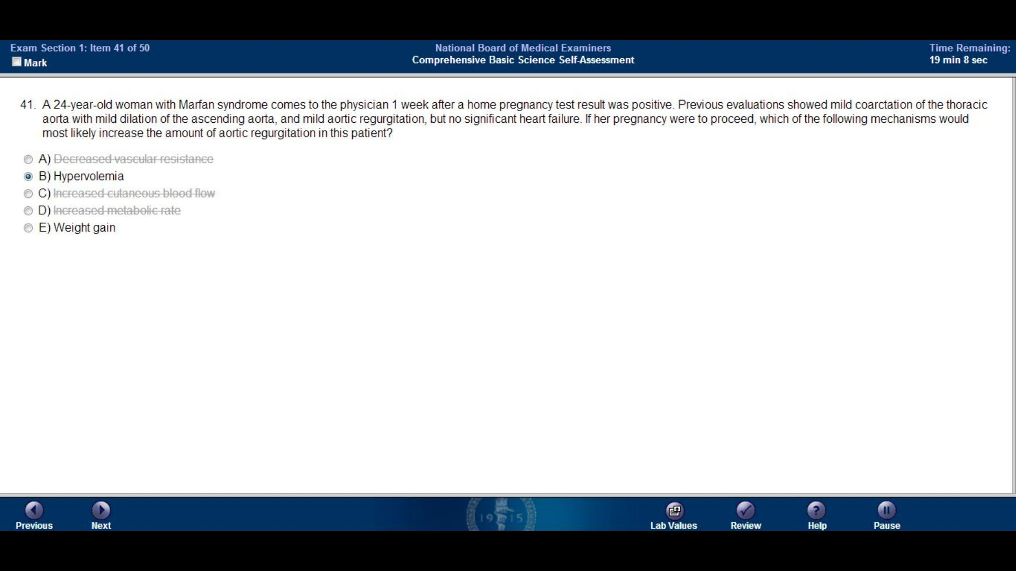
Decreased vascular resistance
Hypervolemia
Increased cutaneous blood flow
Increased metabolic rate
Weight gain

Slide 43
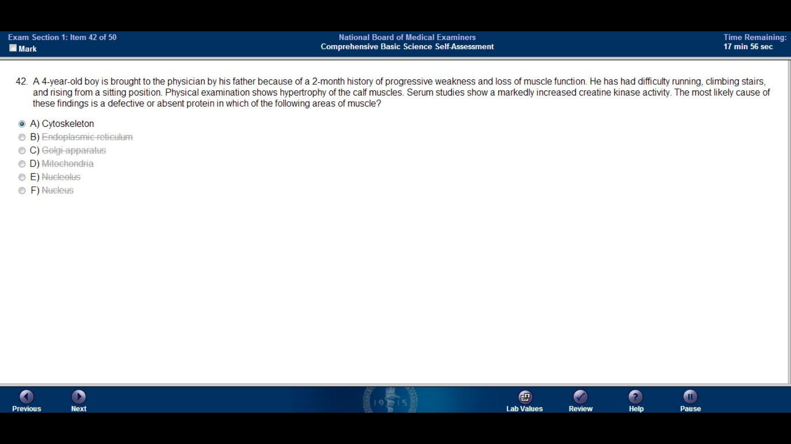
Cytoskeleton
Endoplasmic reticulum
Golgi apparatus
Mitochondria
Nucleolus
Nucleus

Slide 44
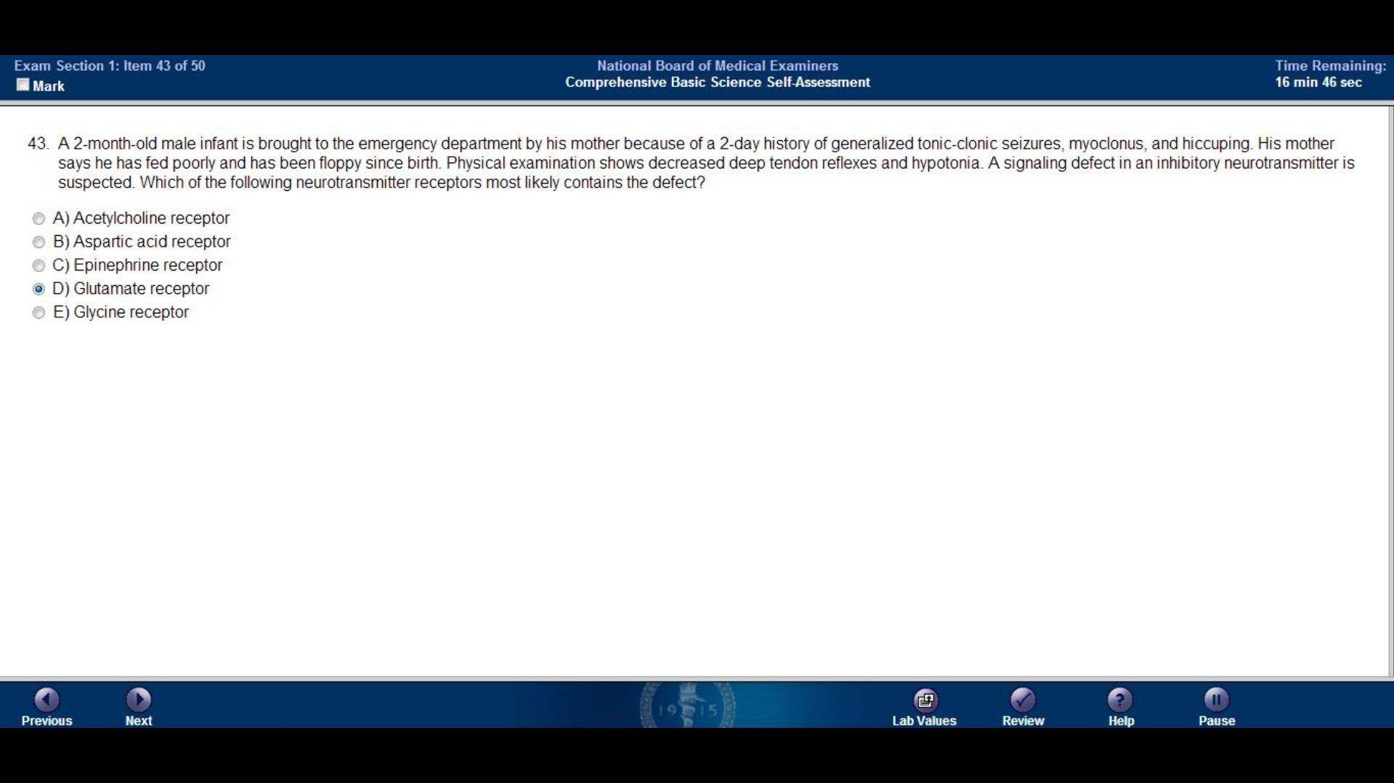

Slide 45
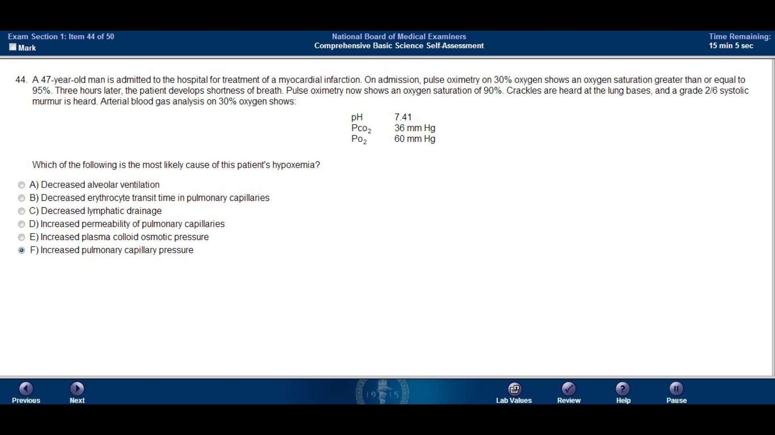

Slide 46
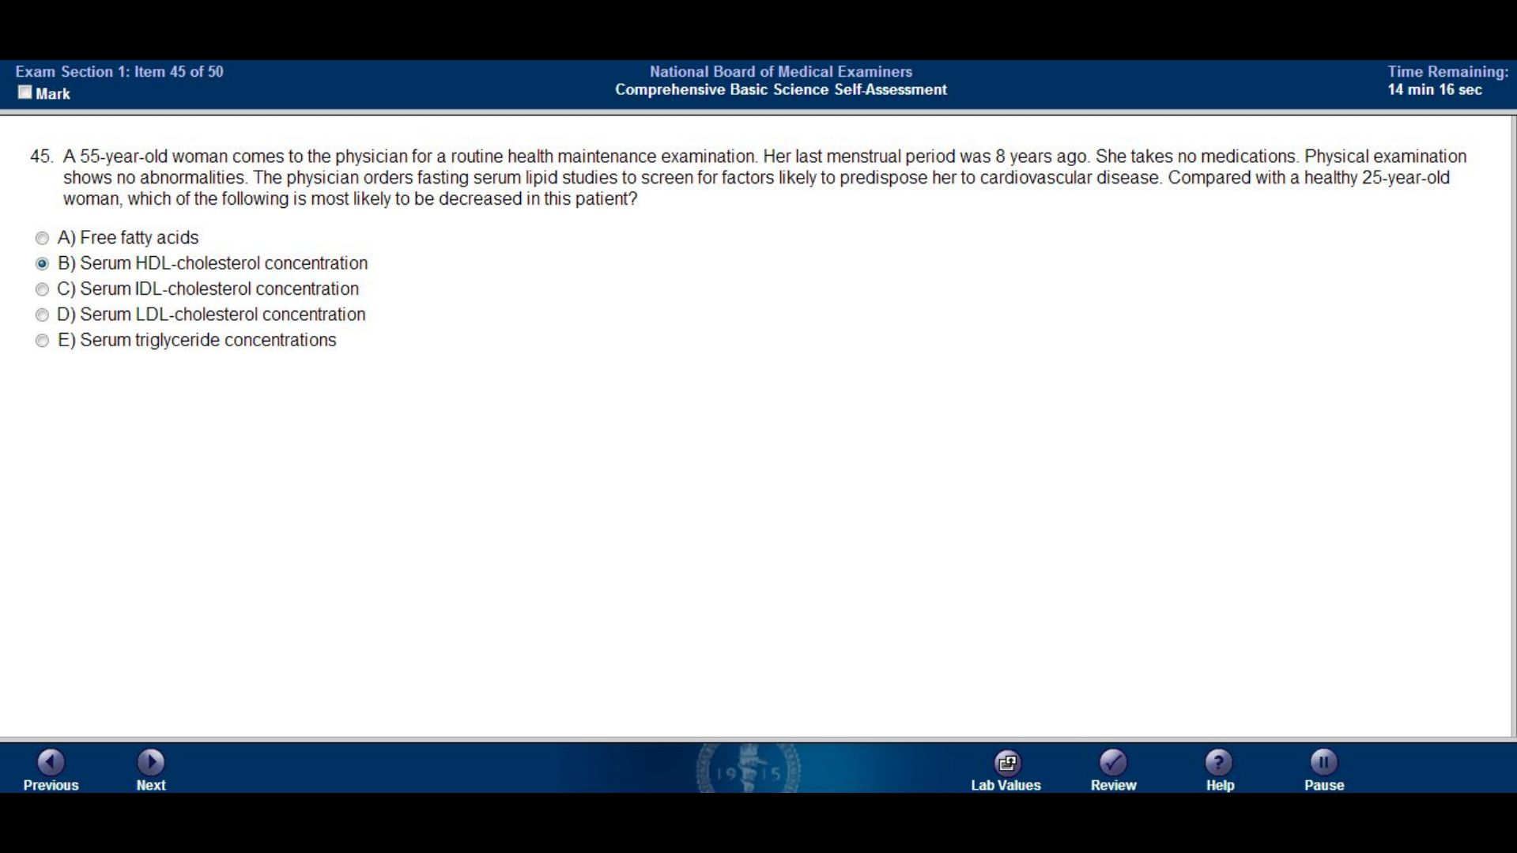

Slide 47
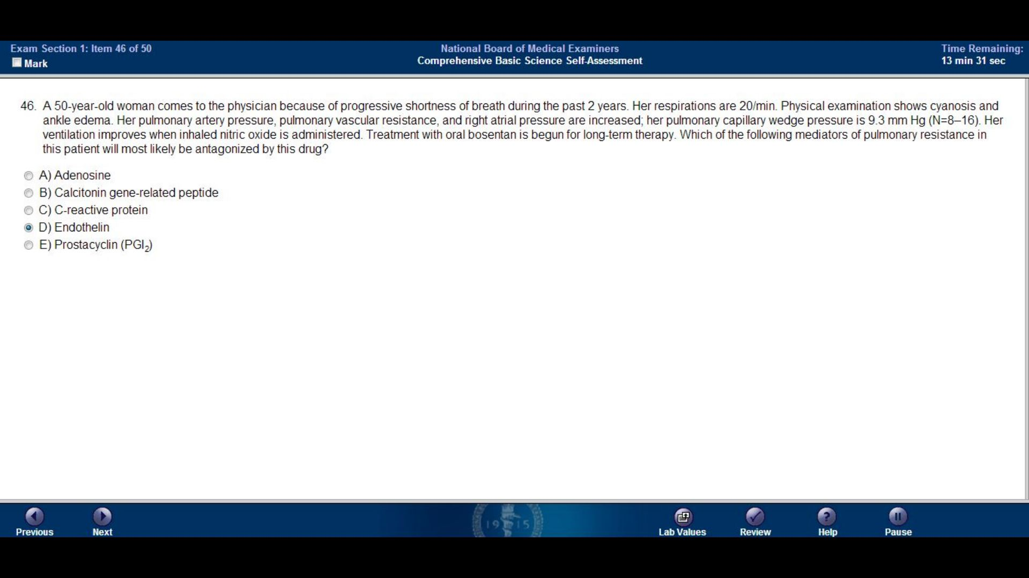

Slide 48
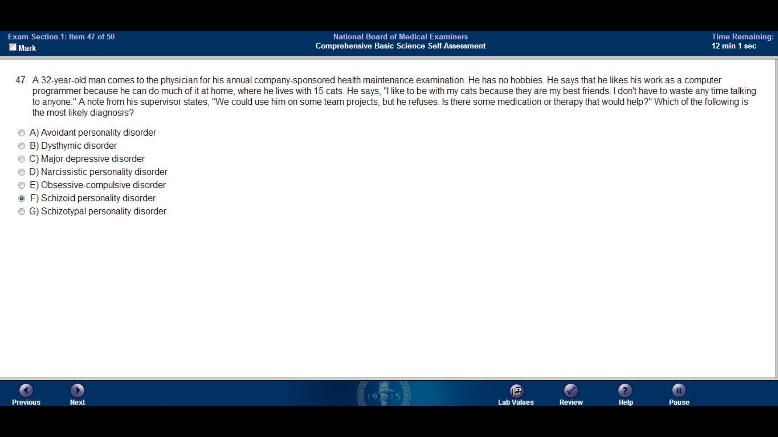

Slide 49
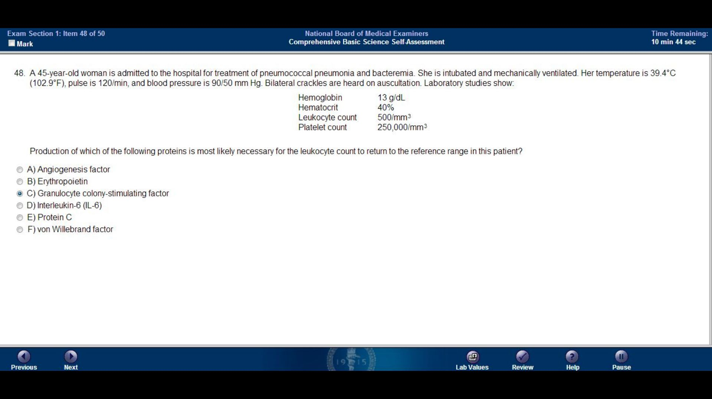

Slide 50
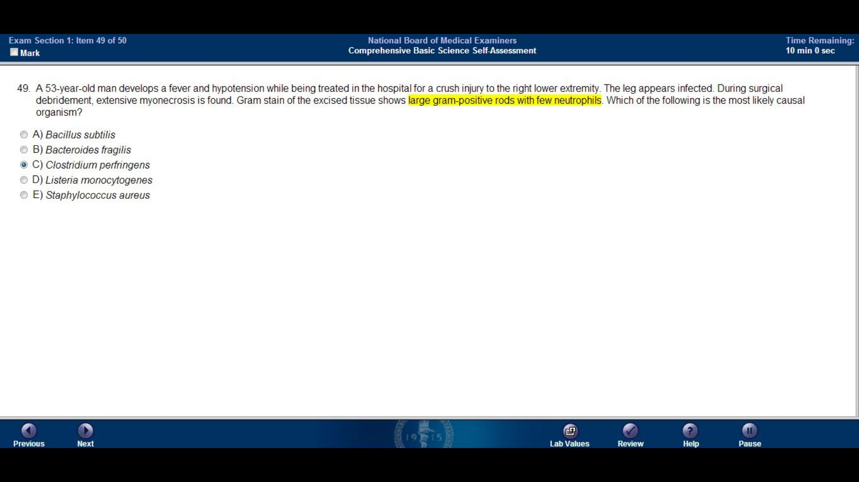

Slide 51


Slide 52
NBME 15 BLOCK 2
Skip to:
Block 1
Block 2
Block 3
Block 4

Slide 53


Slide 54


Slide 55


Slide 56


Slide 57


Slide 58


Slide 59


Slide 60


Slide 61


Slide 62

Anaphylaxis as a result of antibiotic hypersensitivity
Decreased risk for endocarditis
Decreased risk for hemolytic uremic syndrome
Establishment of a chronic carrier state in the spleen
Prolonged fecal excretion of the organism

Slide 63


Slide 64


Slide 65


Slide 66


Slide 67


Slide 68


Slide 69


Slide 70


Slide 71


Slide 72


Slide 73


Slide 74

Anemia
Drug induced alveolar hyperventilation
Residence at a high altitude
Severe regional mismatching of alveolar ventilation and pulmonary capillary perfusion
Voluntary hyperventilation

Slide 75

The cytotrophoblast is present, but the syncytiotrophoblast has not yet formed
Gastrulation is complete, but there are only two germ layers
The neural plate is present, but the neural tube is not yet complete
Placental development is complete, but the embryo is resistant to teratogens
The sclerotome cells have begun migrating, but the somites have not yet formed

Slide 76


Slide 77


Slide 78

Amyl nitrite
Erythropoietin
Ethanol
Hyperbaric oxygen
Physostigmine

Slide 79


Slide 80


Slide 81

7.15 30 30 10
7.28 50 60 27
7.40 30 40 24
7.40 80 70 42
7.50 80 30 24

Slide 82


Slide 83


Slide 84


Slide 85


Slide 86


Slide 87


Slide 88


Slide 89


Slide 90


Slide 91


Slide 92


Slide 93


Slide 94


Slide 95


Slide 96


Slide 97


Slide 98


Slide 99


Slide 100


Slide 101


Slide 102
NBME 15 BLOCK 3
Skip to:
Block 1
Block 2
Block 3
Block 4

Slide 103


Slide 104


Slide 105


Slide 106


Slide 107


Slide 108


Slide 109


Slide 110


Slide 111


Slide 112


Slide 113


Slide 114


Slide 115


Slide 116


Slide 117


Slide 118


Slide 119


Slide 120


Slide 121


Slide 122


Slide 123


Slide 124


Slide 125


Slide 126


Slide 127


Slide 128


Slide 129


Slide 130


Slide 131


Slide 132


Slide 133


Slide 134


Slide 135

1 0.5 0.5
1 1 1
2 0.2 0.2
5 0.2 0.1
15 1 1

Slide 136


Slide 137


Slide 138


Slide 139


Slide 140


Slide 141


Slide 142


Slide 143


Slide 144


Slide 145


Slide 146


Slide 147


Slide 148


Slide 149


Slide 150


Slide 151

40 50 35
40 60 40
50 25 10
50 80 10
60 35 25

Slide 152


Slide 153
NBME 15 BLOCK 4
Skip to:
Block 1
Block 2
Block 3
Block 4

Slide 154


Slide 155


Slide 156


Slide 157


Slide 158


Slide 159


Slide 160


Slide 161


Slide 162


Slide 163


Slide 164


Slide 165


Slide 166


Slide 167


Slide 168


Slide 169


Slide 170


Slide 171

Increased increased no change
Increased decreased decreased
No change increased decreased
Decreased no change decreased
Decreased decreased increased

Slide 172


Slide 173


Slide 174


Slide 175


Slide 176


Slide 177


Slide 178


Slide 179



Slide 180


Slide 181


Slide 182

Endometrial tissues become hyperplastic in the absence of estrogen
The patient has been noncompliant in taking the estrogen receptor antagonist
The patient’s breast cancer has metastasized to the patient’s uterus
The patient’s breast cancer is associated with an estrogen secreting ovarian cancer
The patient’s medication has an agonist effect on endometrial estrogen receptors
The patient’s serum estrogen concentrations are increased due to ectopic production of human chorionic gonadotropin

Slide 183


Slide 184


Slide 185


Slide 186


Slide 187


Slide 188


Slide 189


Slide 190


Slide 191


Slide 192


Slide 193

“Glucosamine hasn’t been studied well enough for me to recommend it.”
“Glucosamine’s side effects aren’t listed. It may be more dangerous than we realize.”
“Ibuprofen has been proven effective for your condition.”
“What have you heard about using glucosamine to treat arthritis?”
“Why did you come to me if you don’t want to take what I recommend?”
“You should really see a naturopathic doctor.”

Slide 194


Slide 195

Occipital lobe
Optic Chiasm
Optic nerve
Parietal lobe
Temporal lobe

Slide 196


Slide 197


Slide 198

Calcium absorption from the gut
Calcium concentration in feces
Calcium concentration in muscle
Calcium concentration in plasma
Calcium loss from bone

Slide 199


Slide 200

Advanced paternal age
Consanguinity
De novo mutation
Genomic imprinting
Germline mosaicism

Slide 201


Slide 202

Calcium carbonate
Cimetidine
Metoclopramide
Omeprazole
Sucralfate

Slide 203


